Slide 1
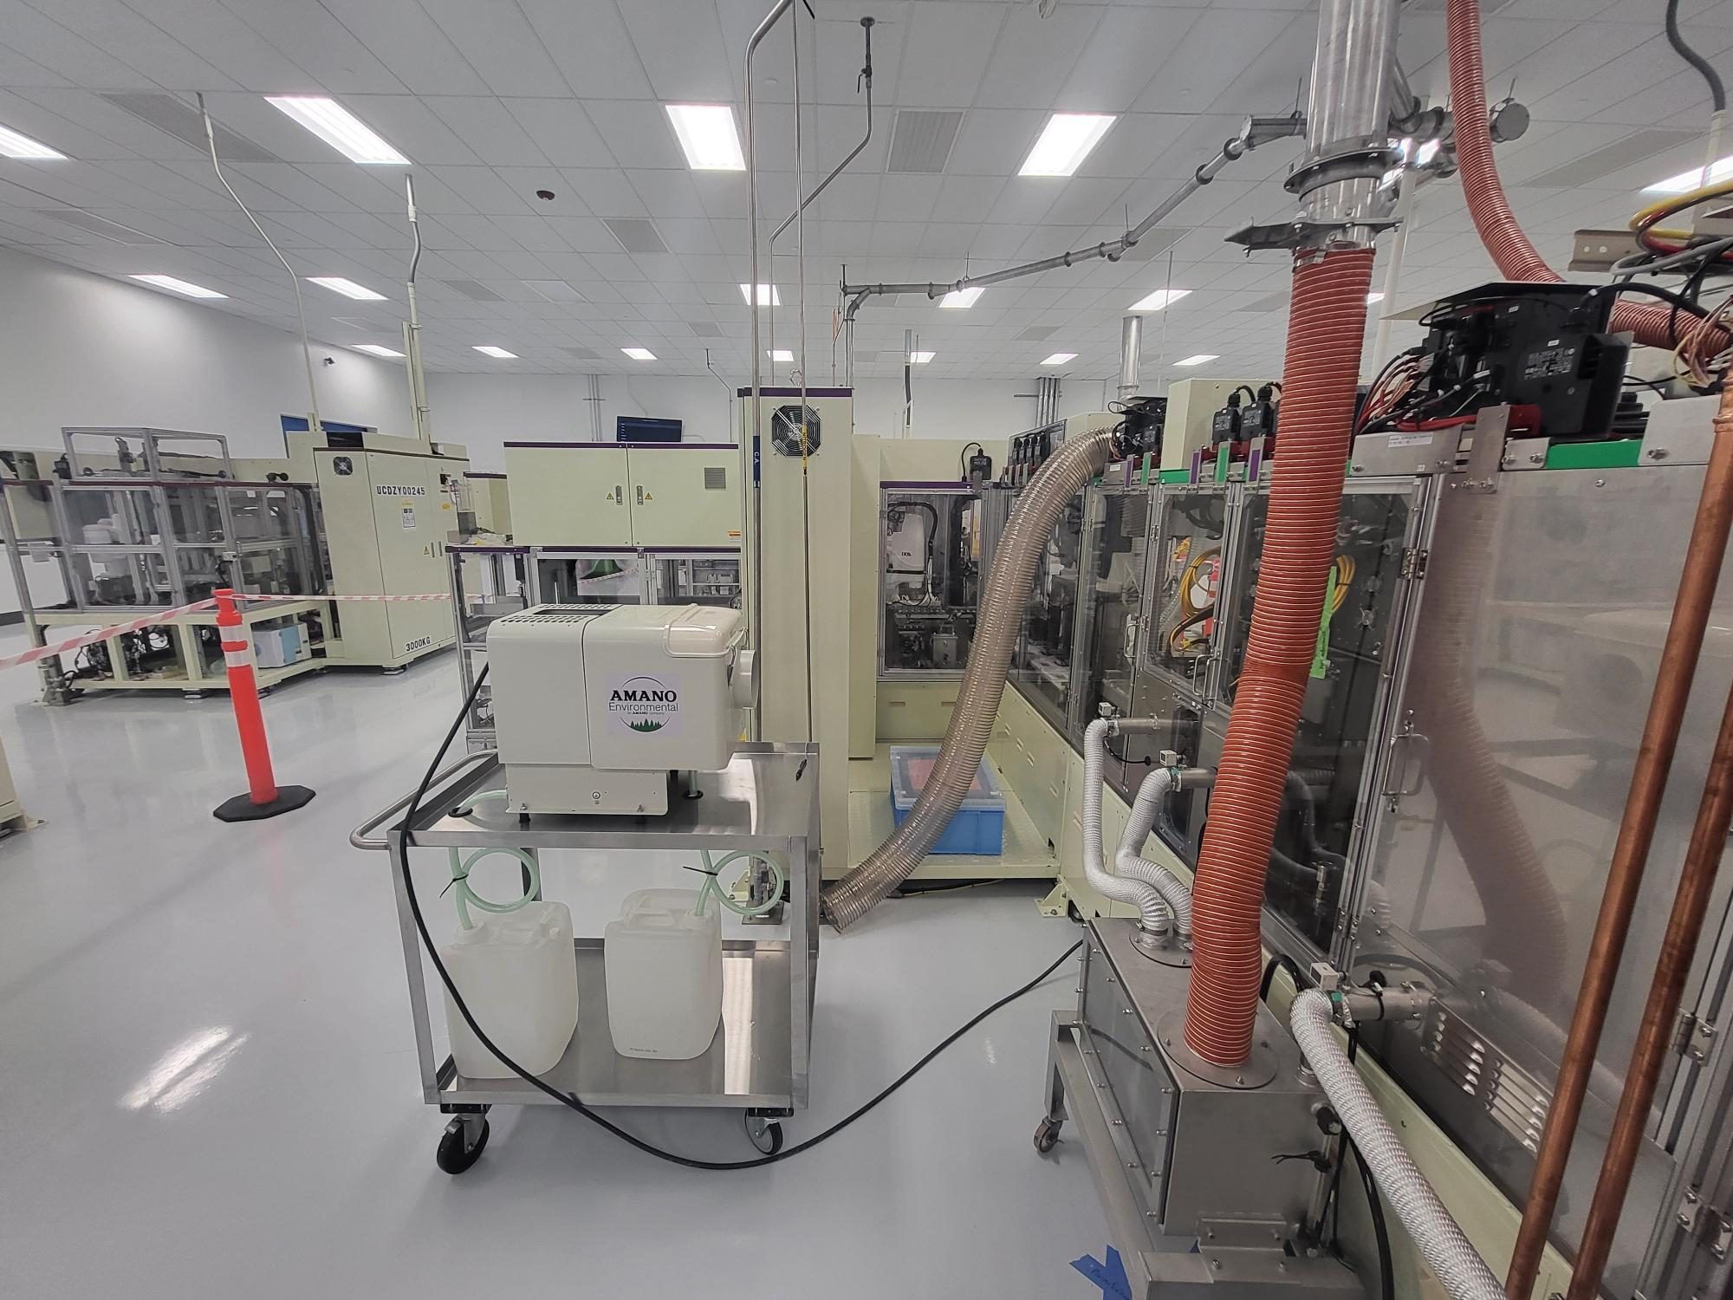

Oil Mist Collector
3/12/2024
Battery
Notes:
JIS??

Slide 2
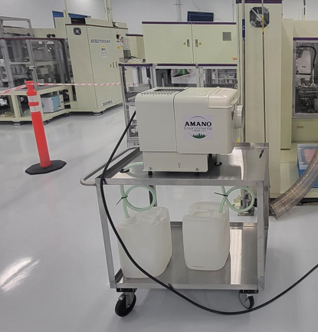
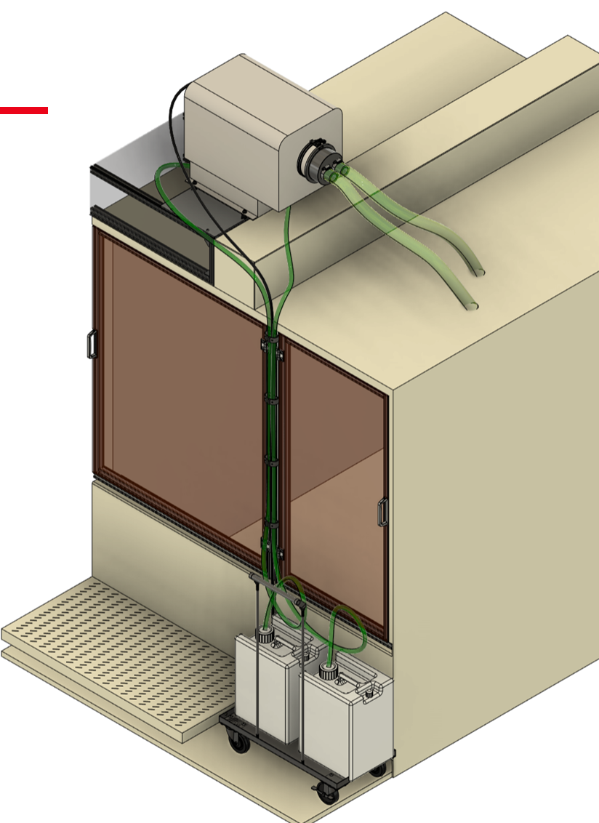
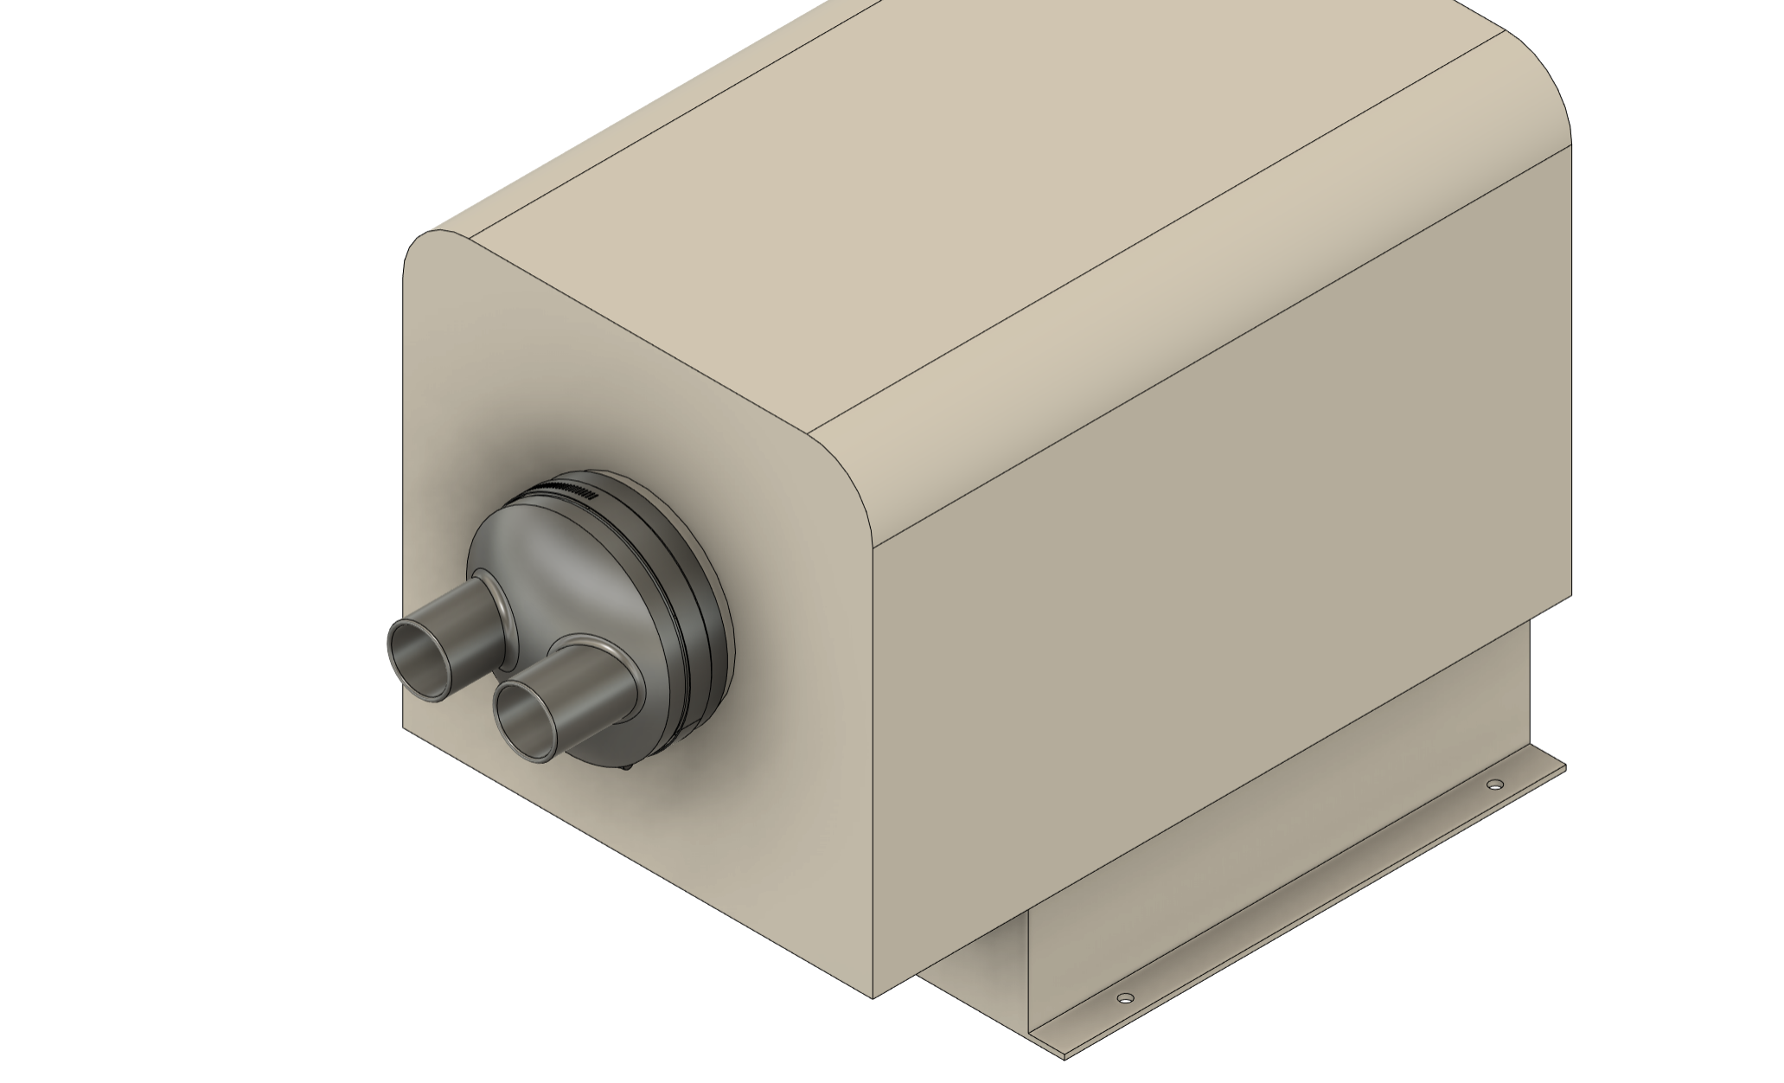

Slide 3
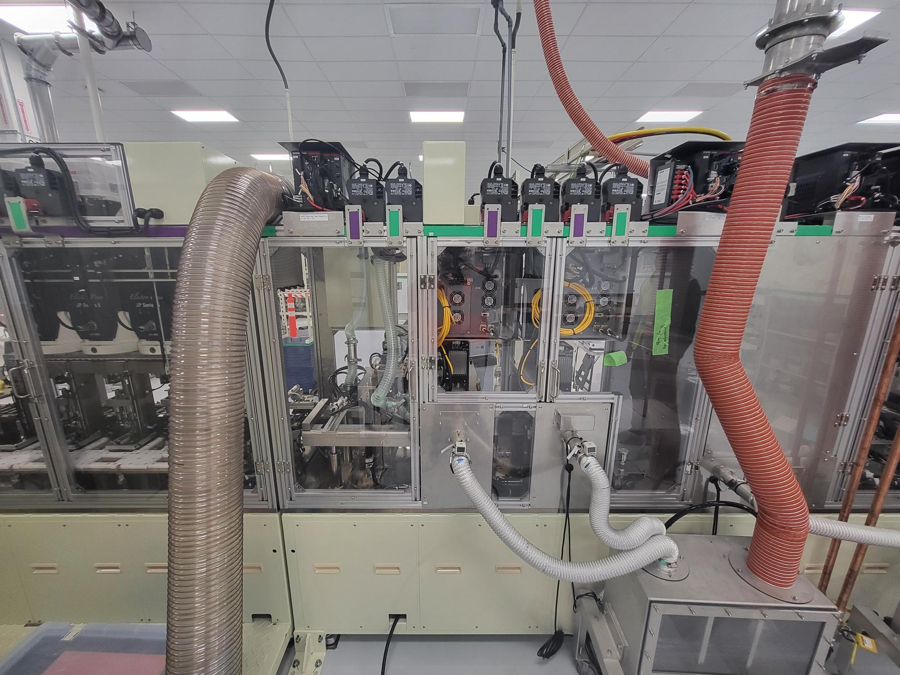
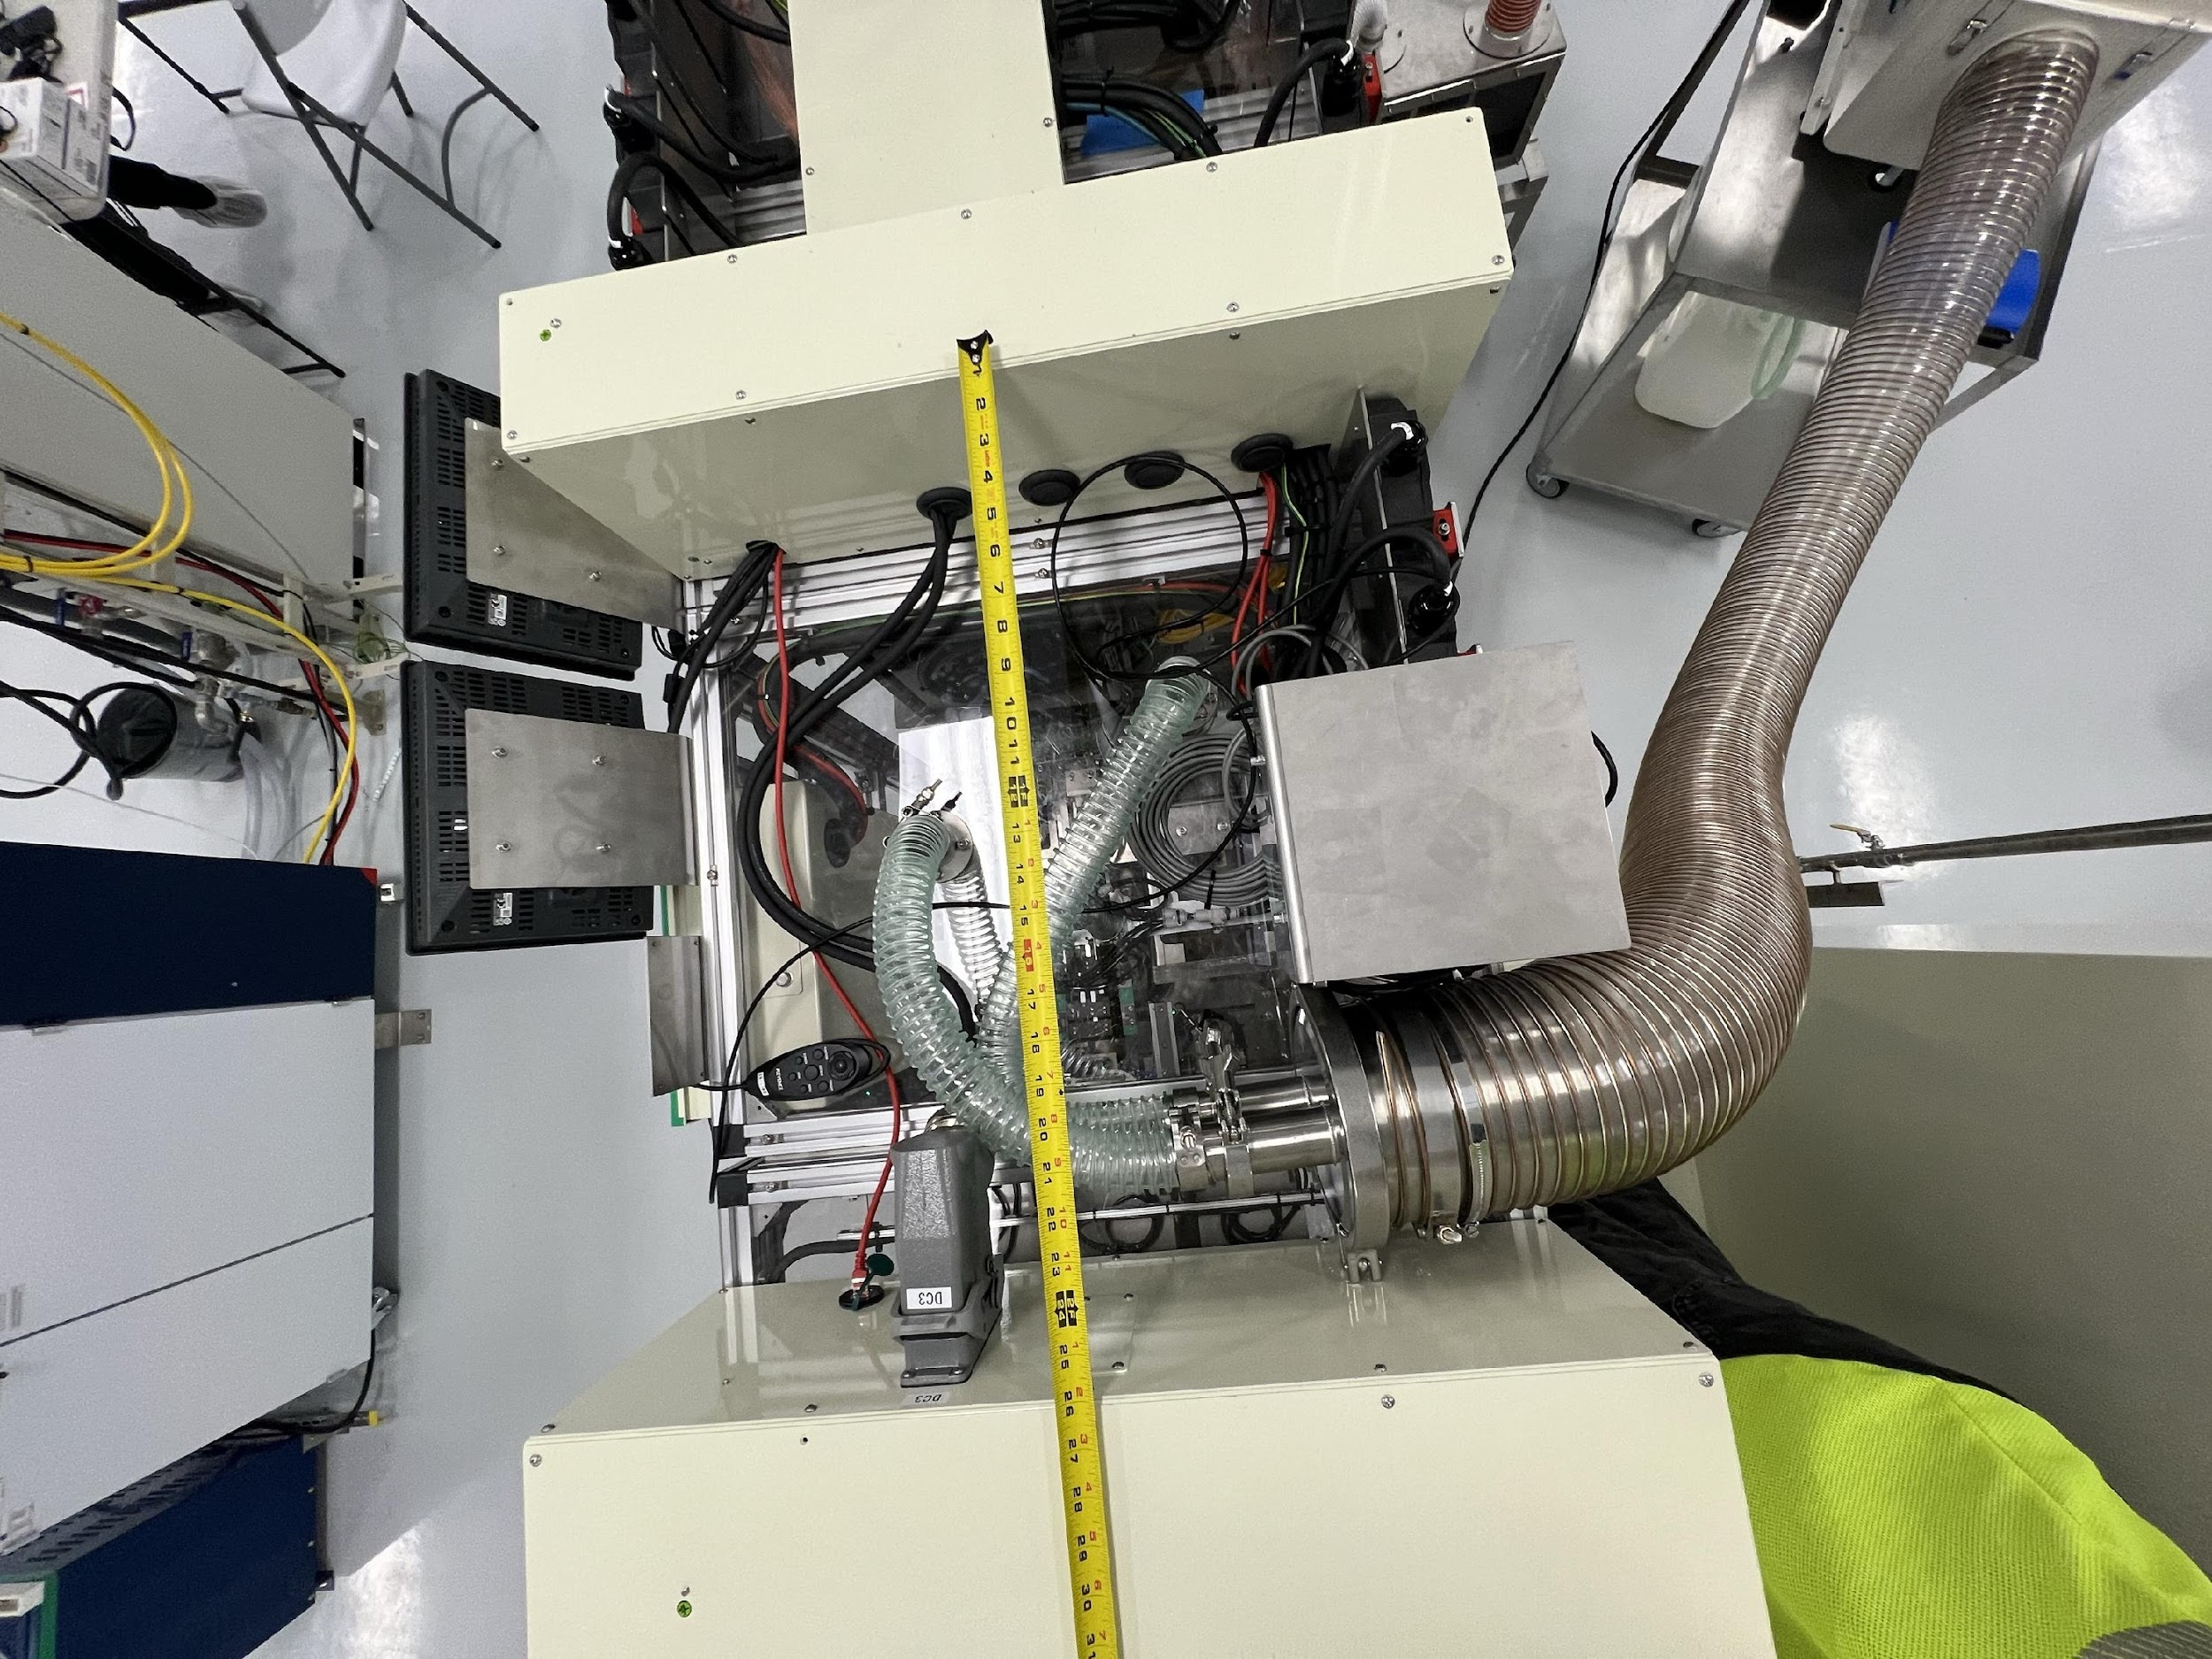
Overview
BATTERY
Current Situation

Slide 4
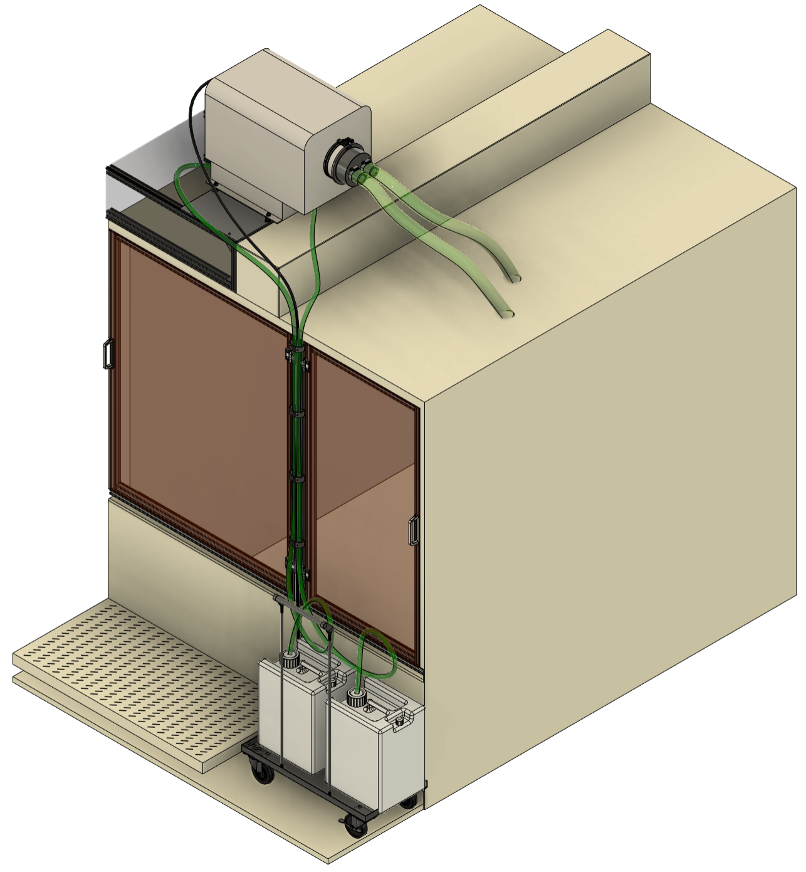
Overview
BATTERY
Proposed Solution
Modify space above cathode presses to place Mist Collector
Custom 2in to 6in hose adapter
Hose/cable management between doors
Cart for oil collection

Slide 5
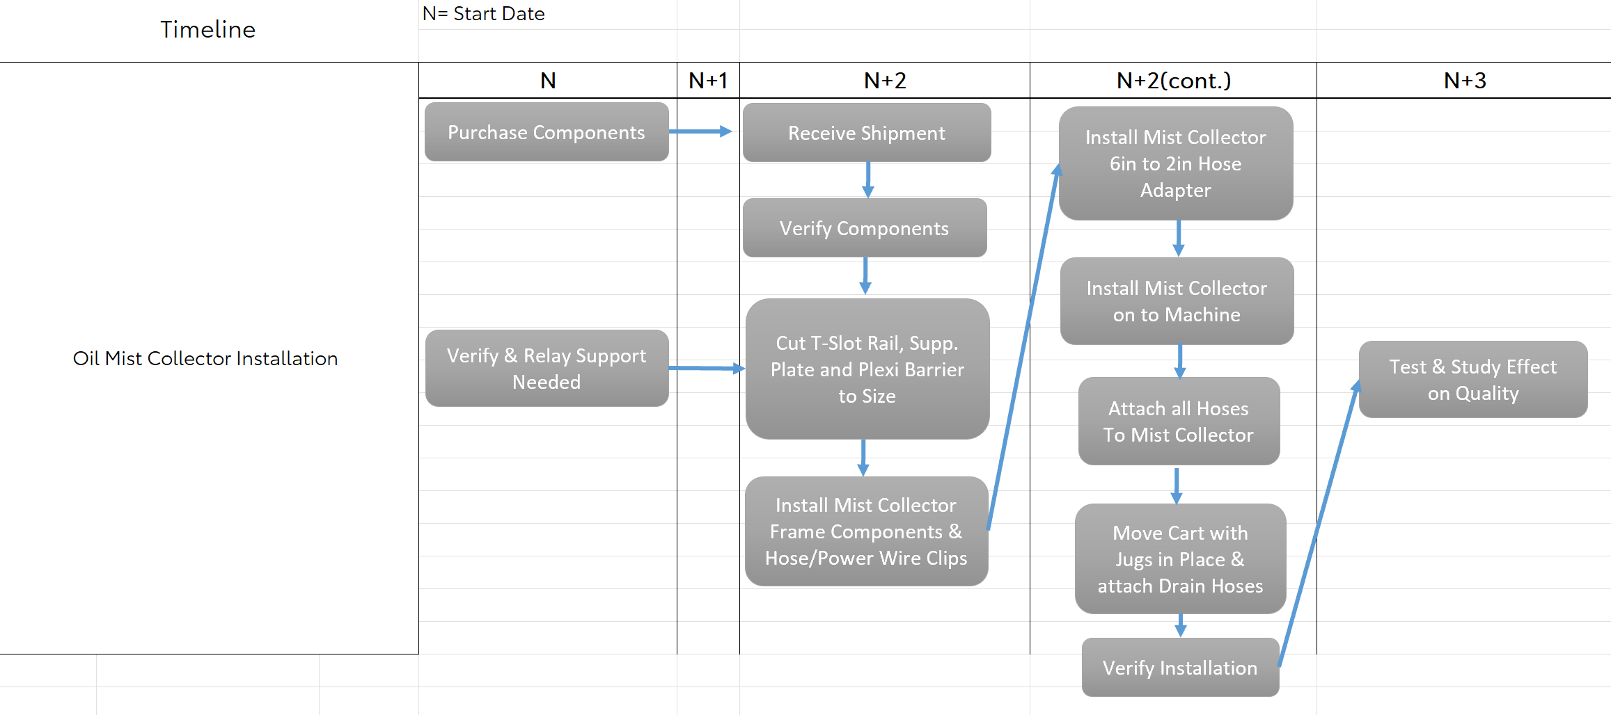
Timeline
BATTERY

Slide 6
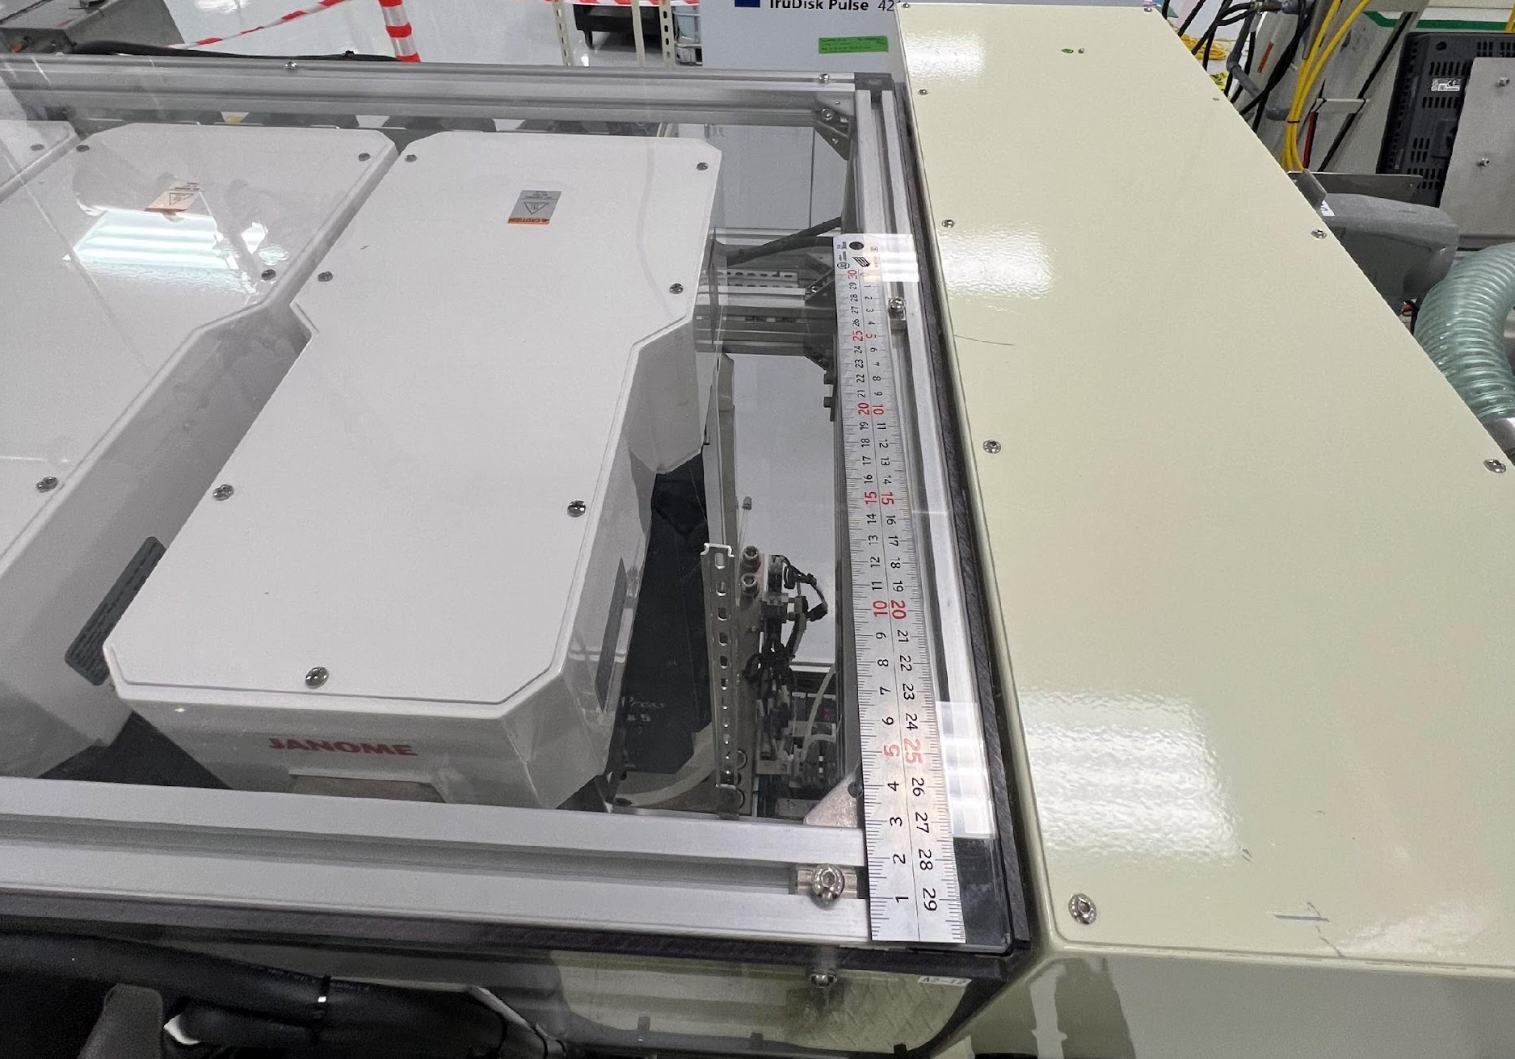
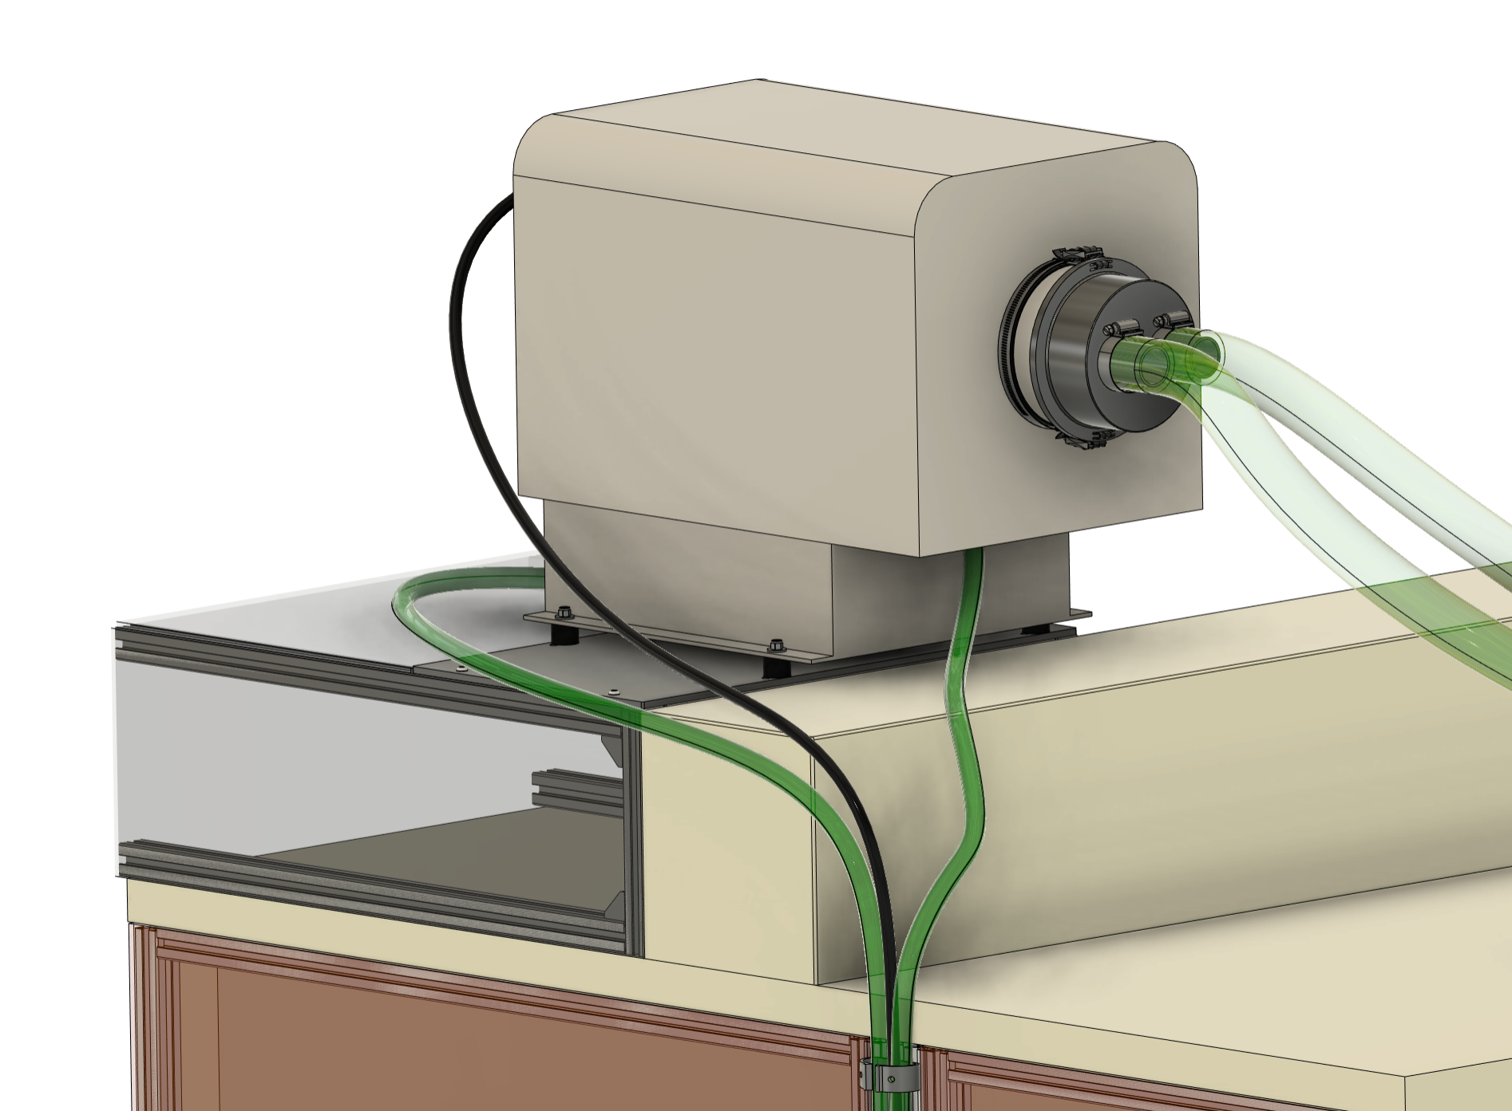
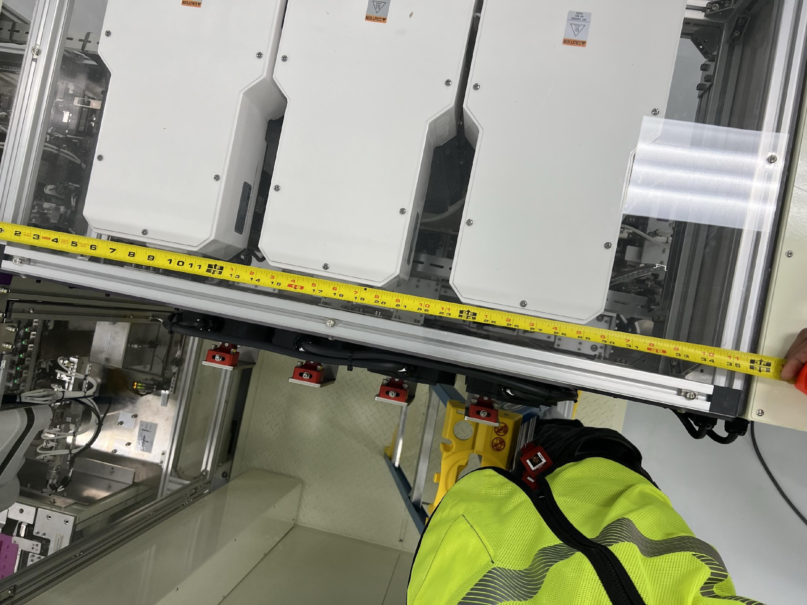
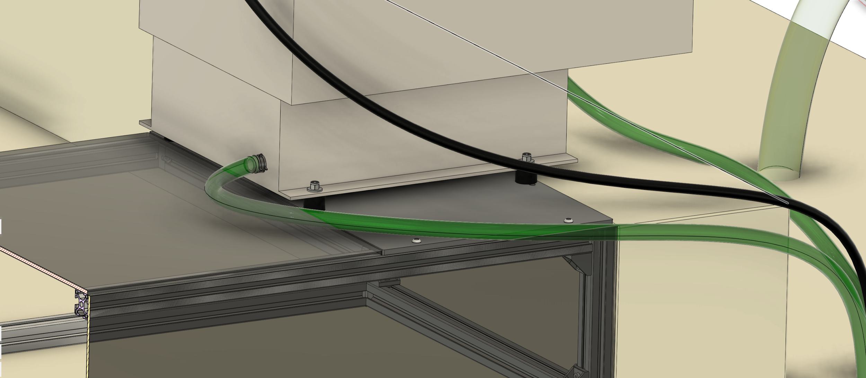
Modification of Target Area
BATTERY
Modify Plexiglass
Install crossbar
Install 1/4in thick Alu. plate
Current
Proposed

Slide 7

Modify Plexiglass
BATTERY
Reuse attachment holes & screws
Notes:
Square with hatch

Slide 8
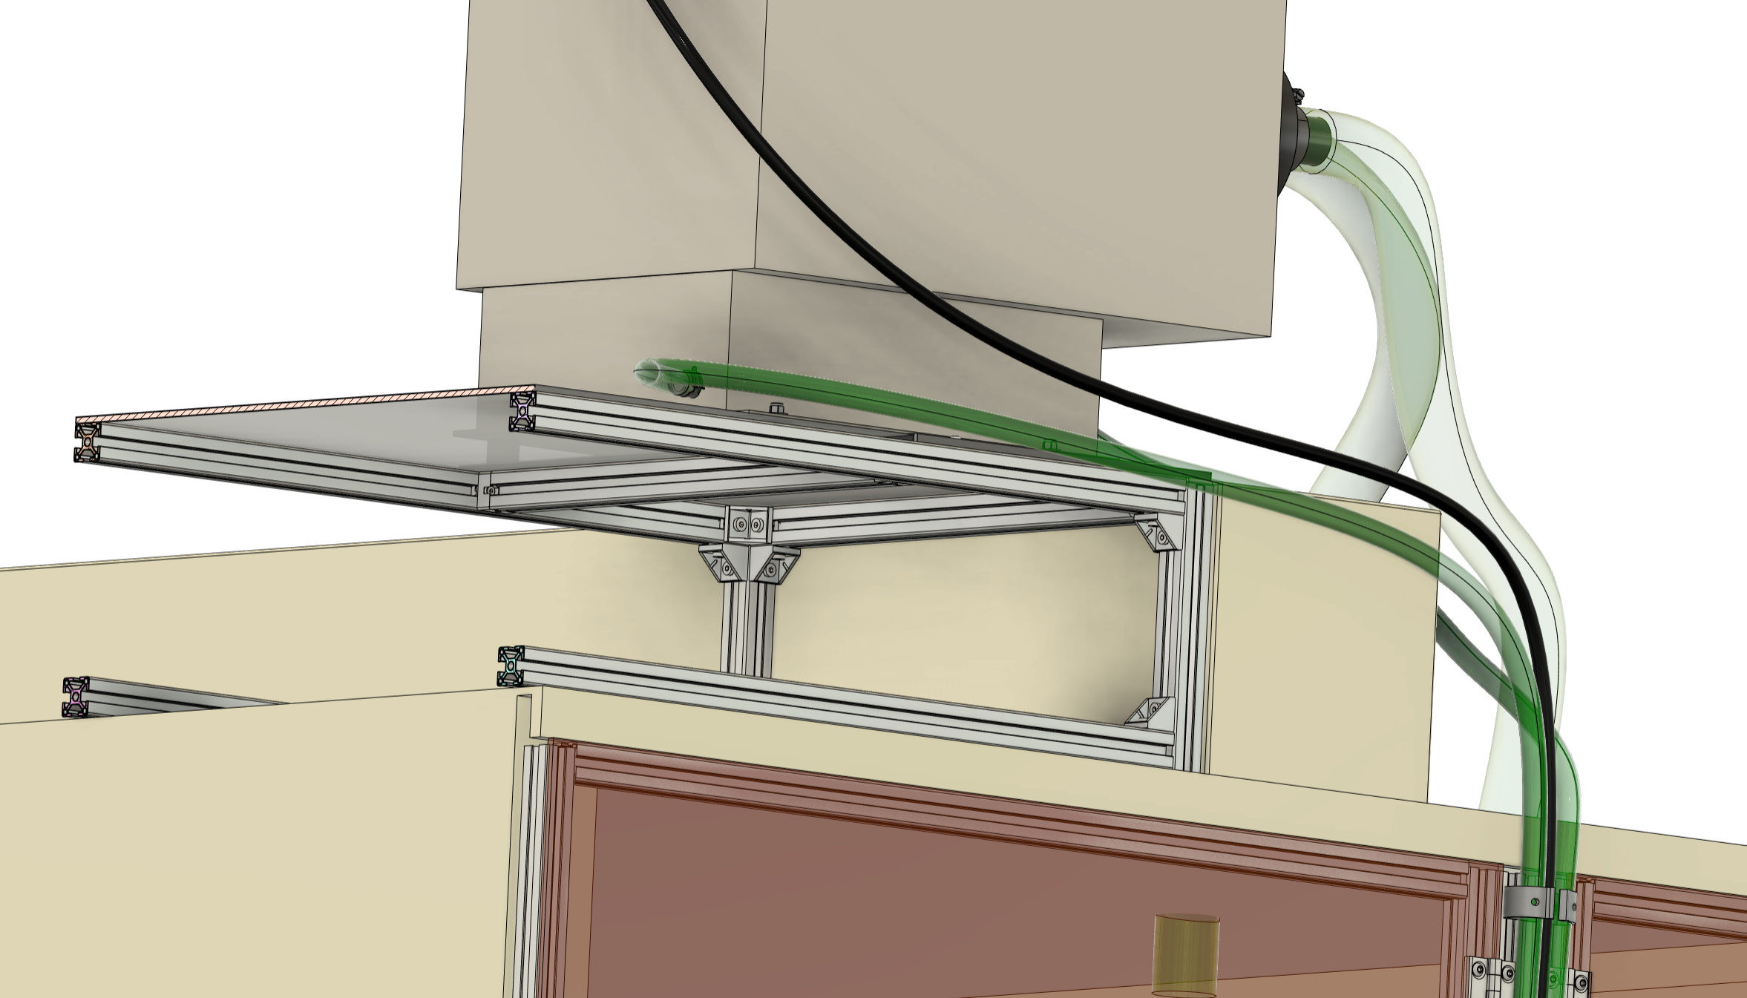
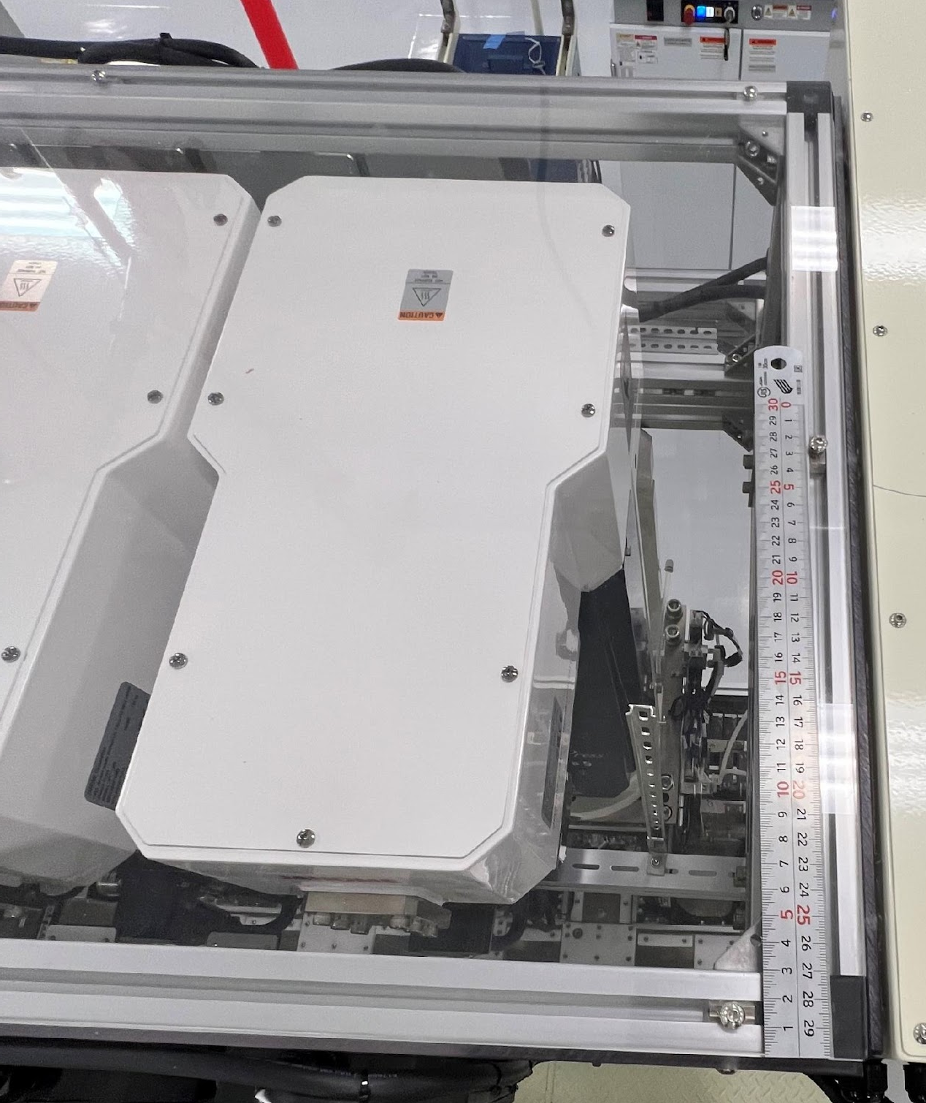
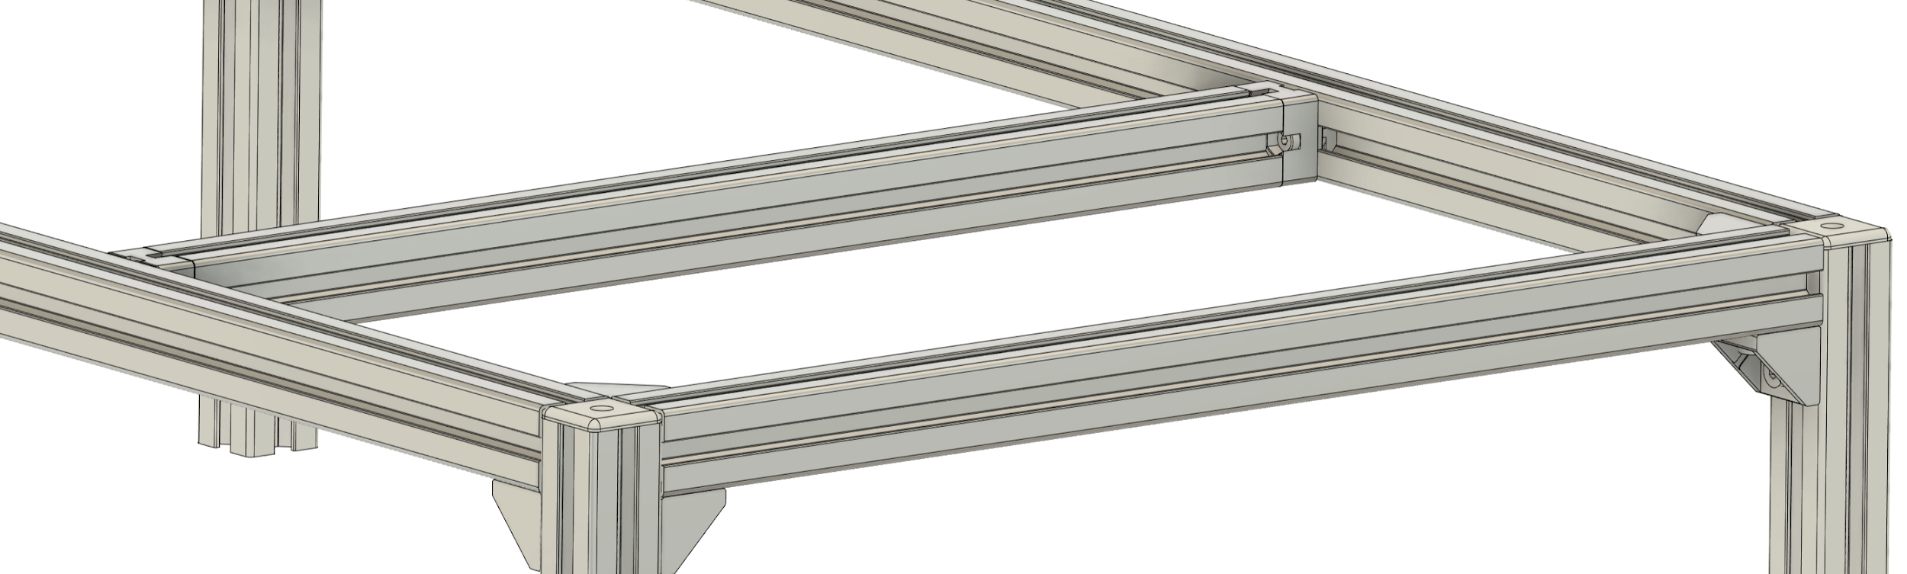
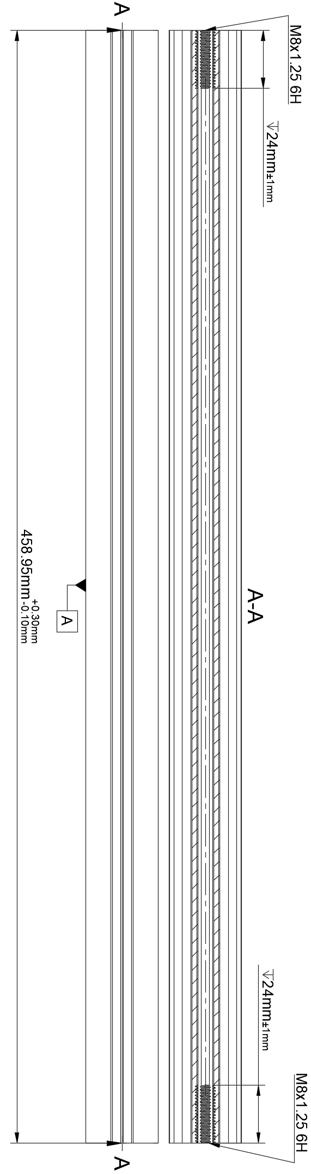
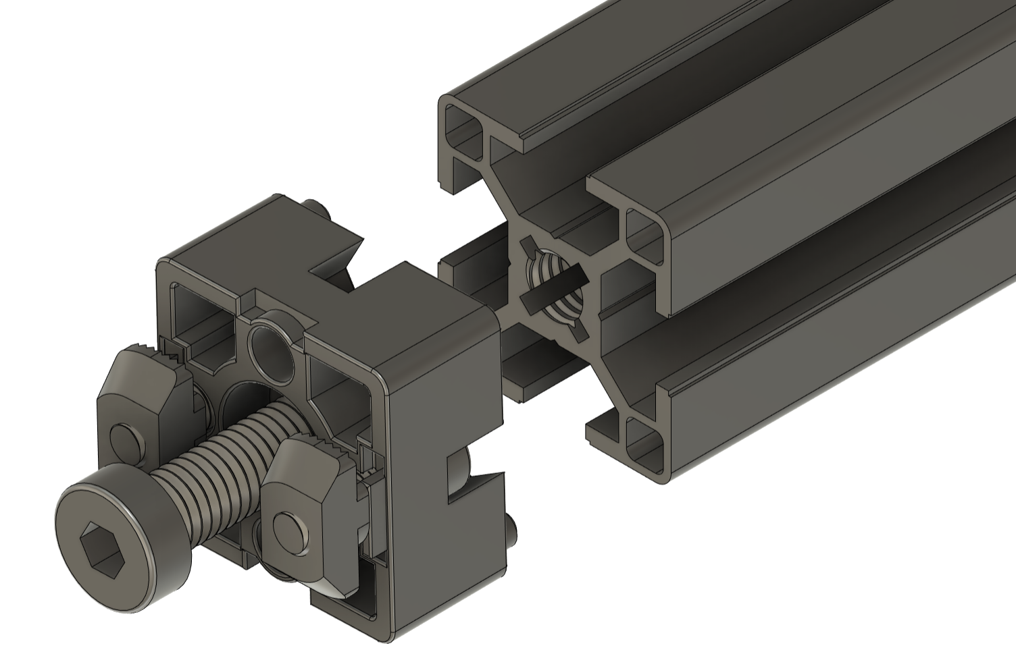
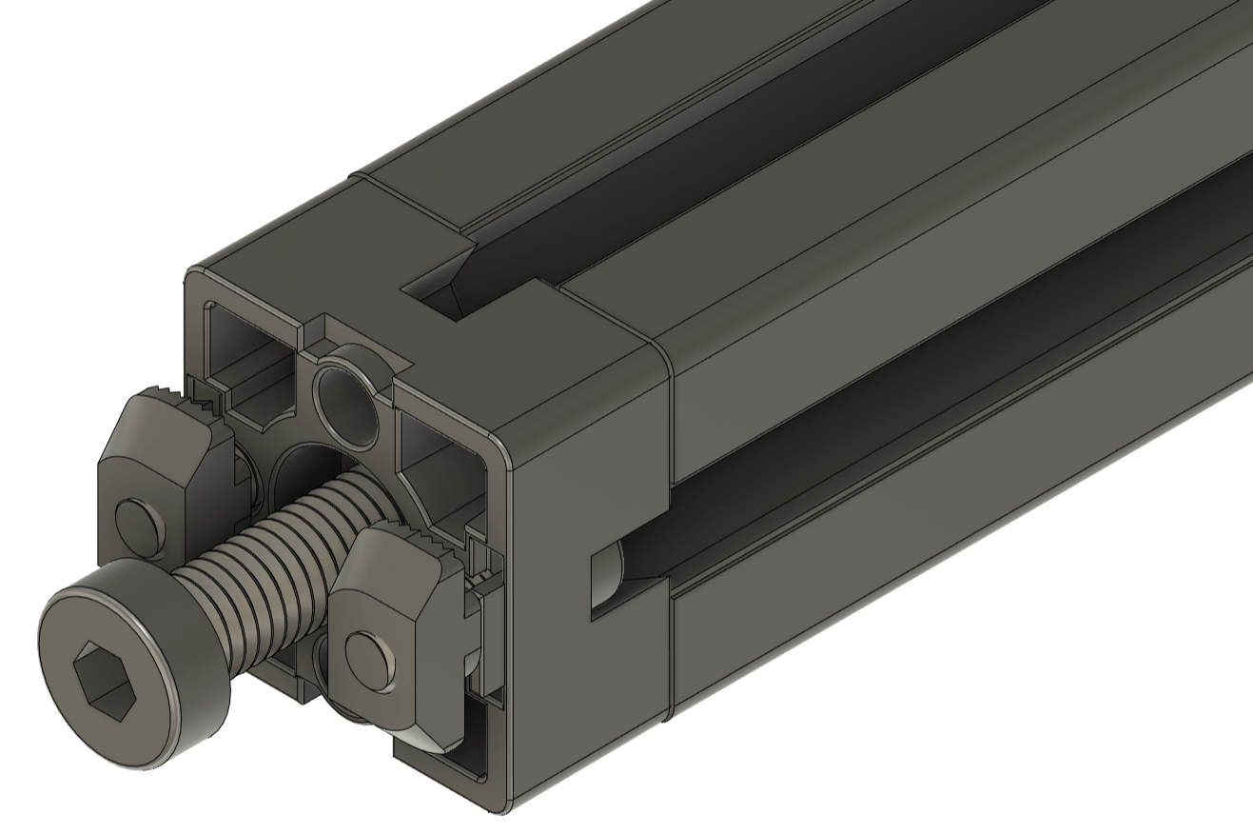
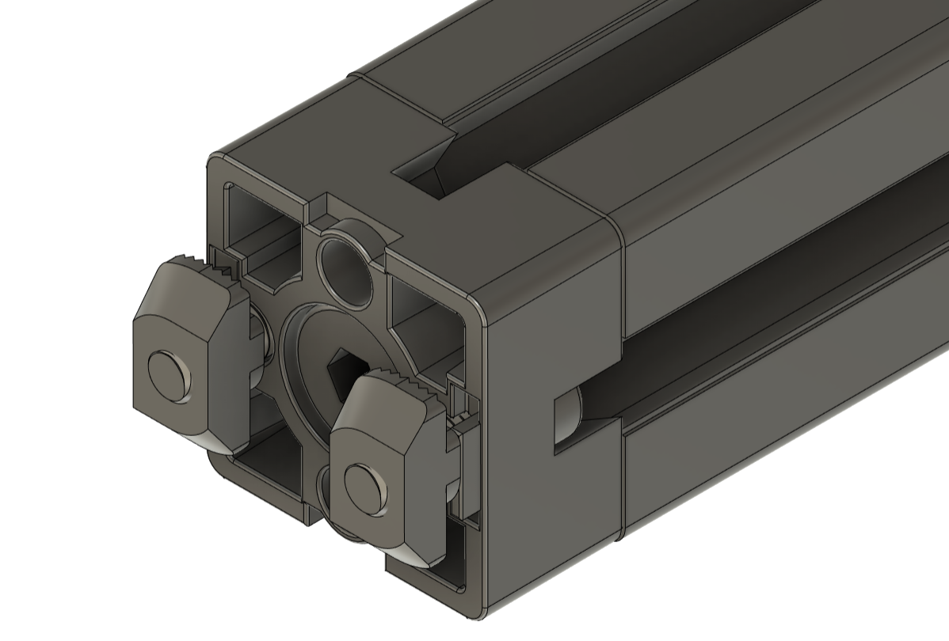
Crossbar Setup
BATTERY
280mm

Slide 9
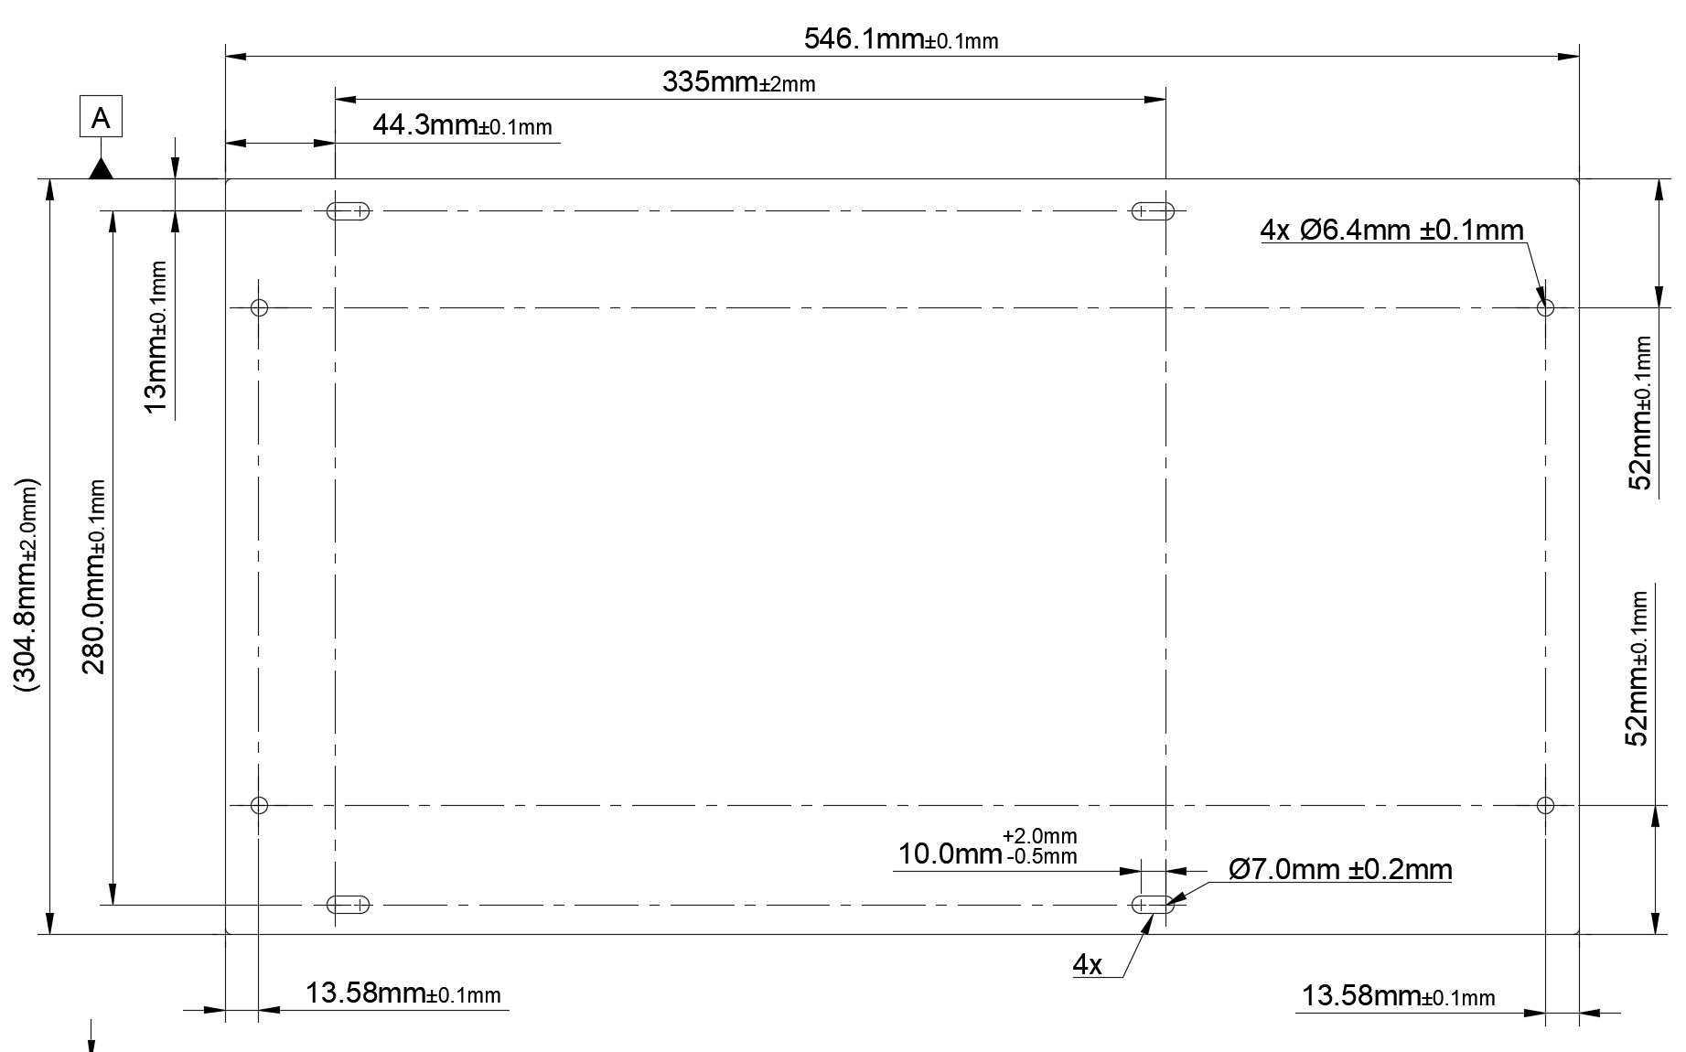
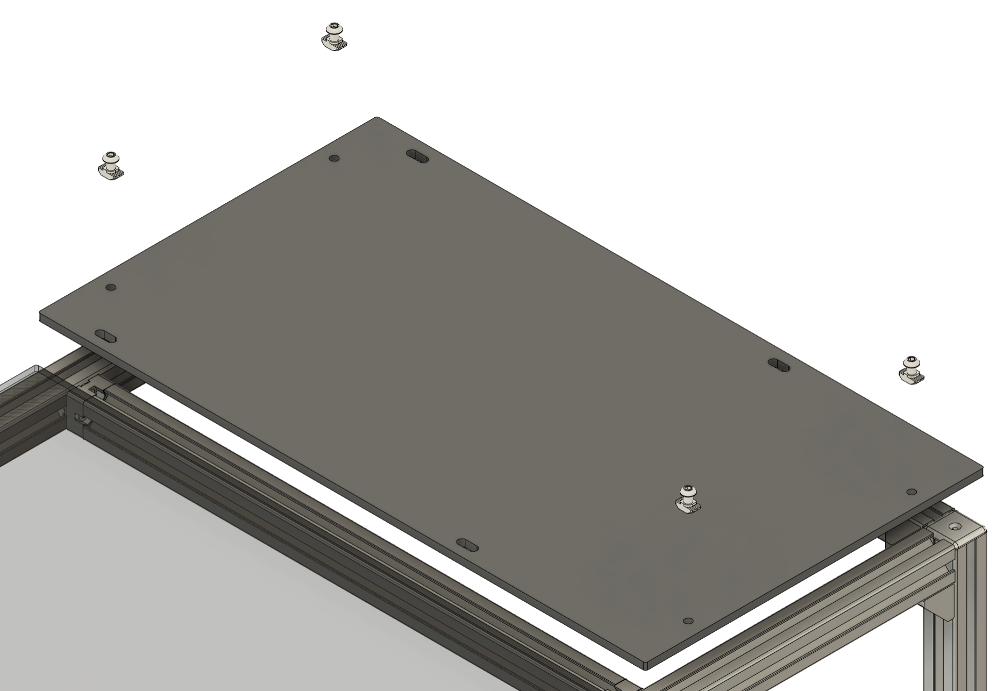
Aluminum Plate
BATTERY
Note: Install Vibration Dampers T-slot Nuts before screwing on aluminum Plate

Slide 10
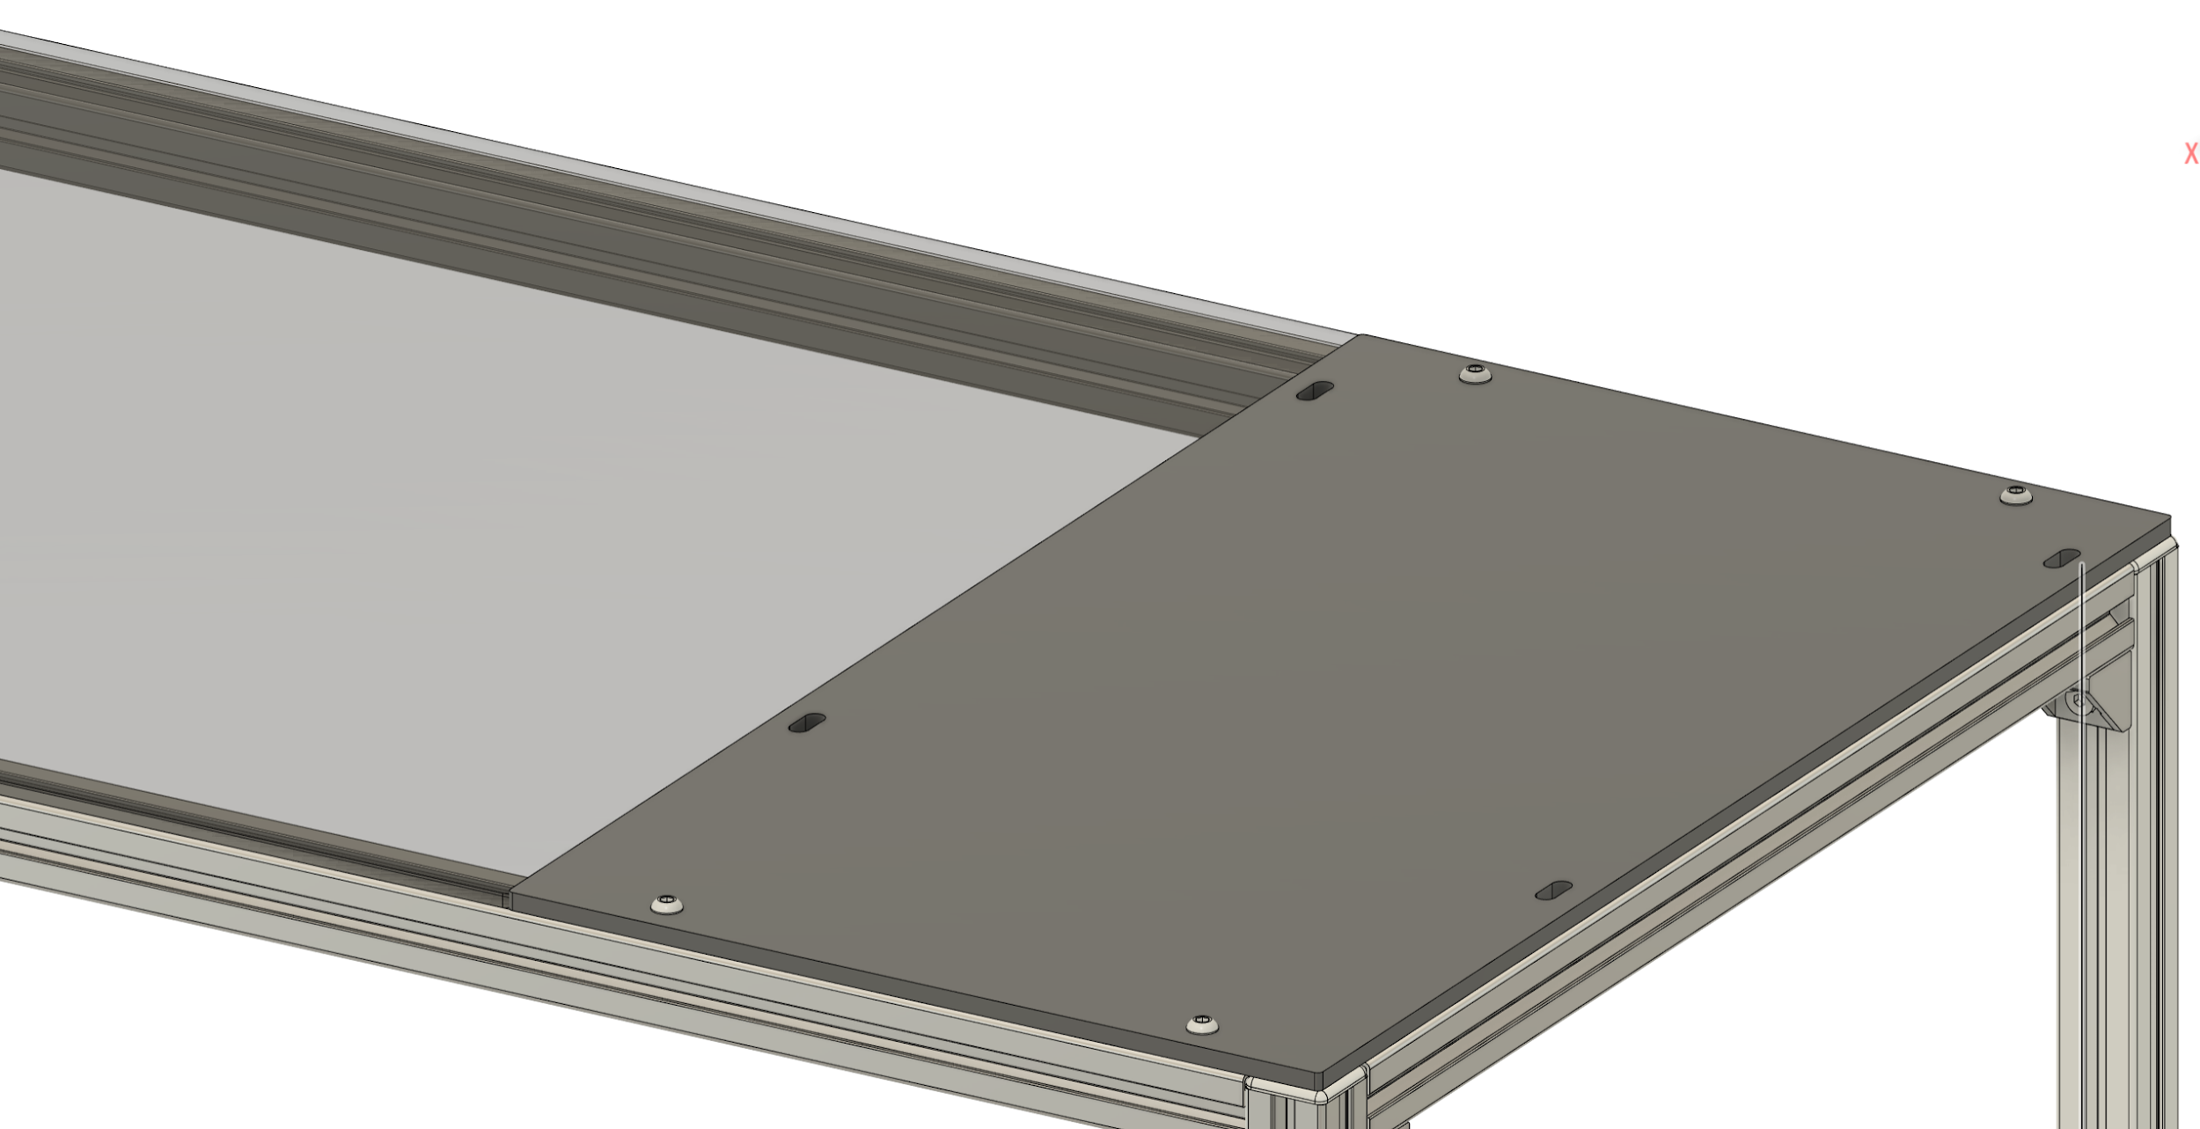
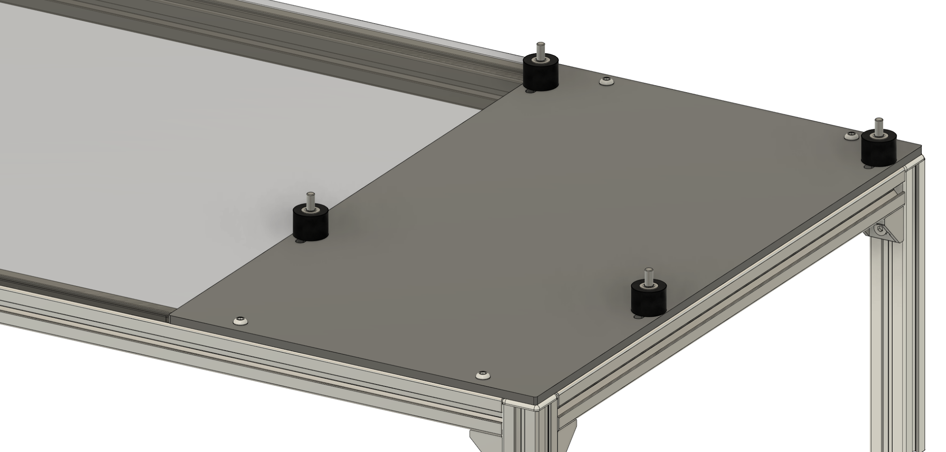

Aluminum Plate Pt.2
BATTERY
Vibration Dampers

Slide 11
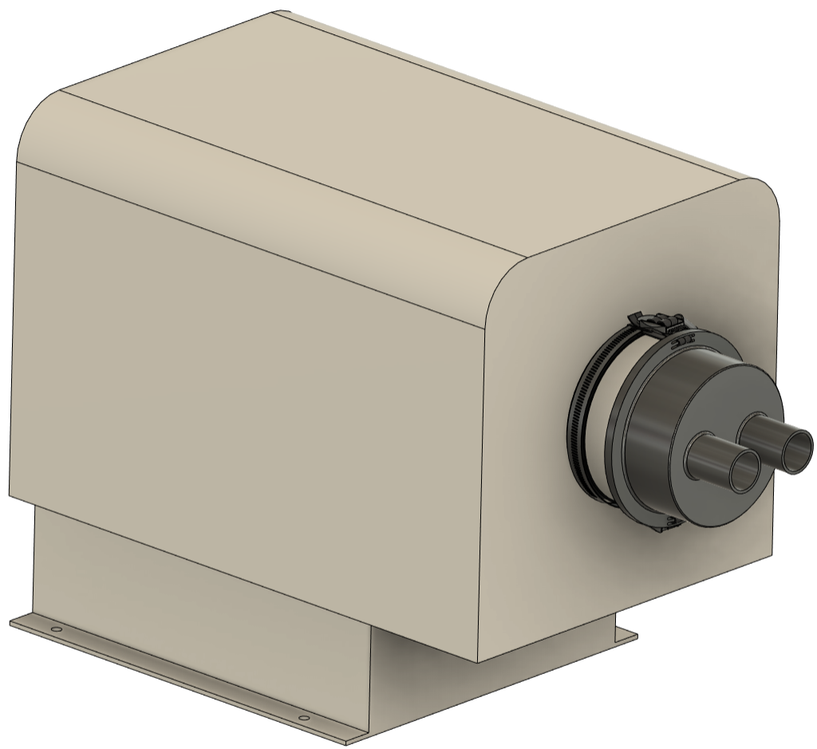
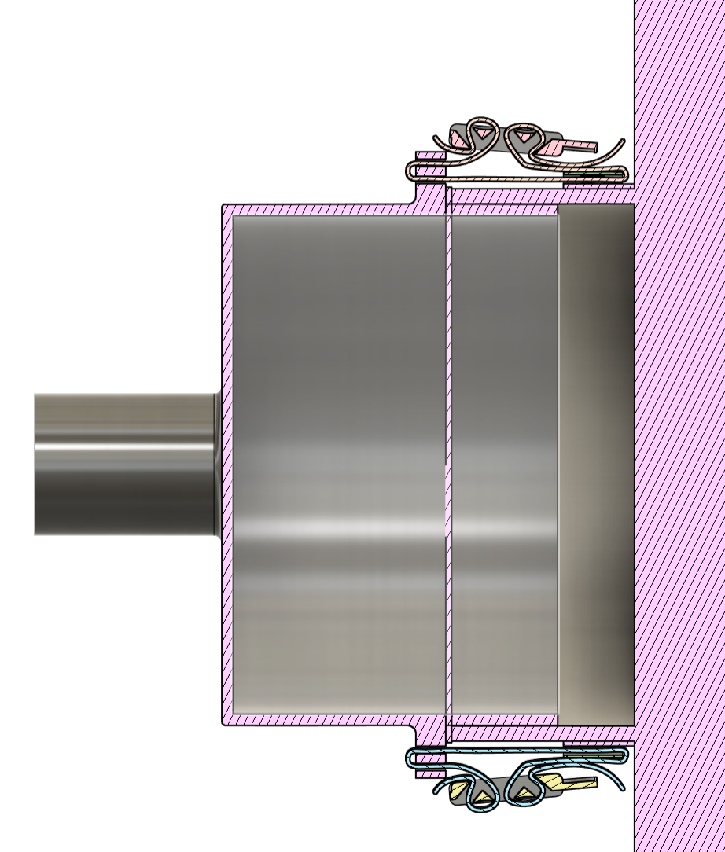
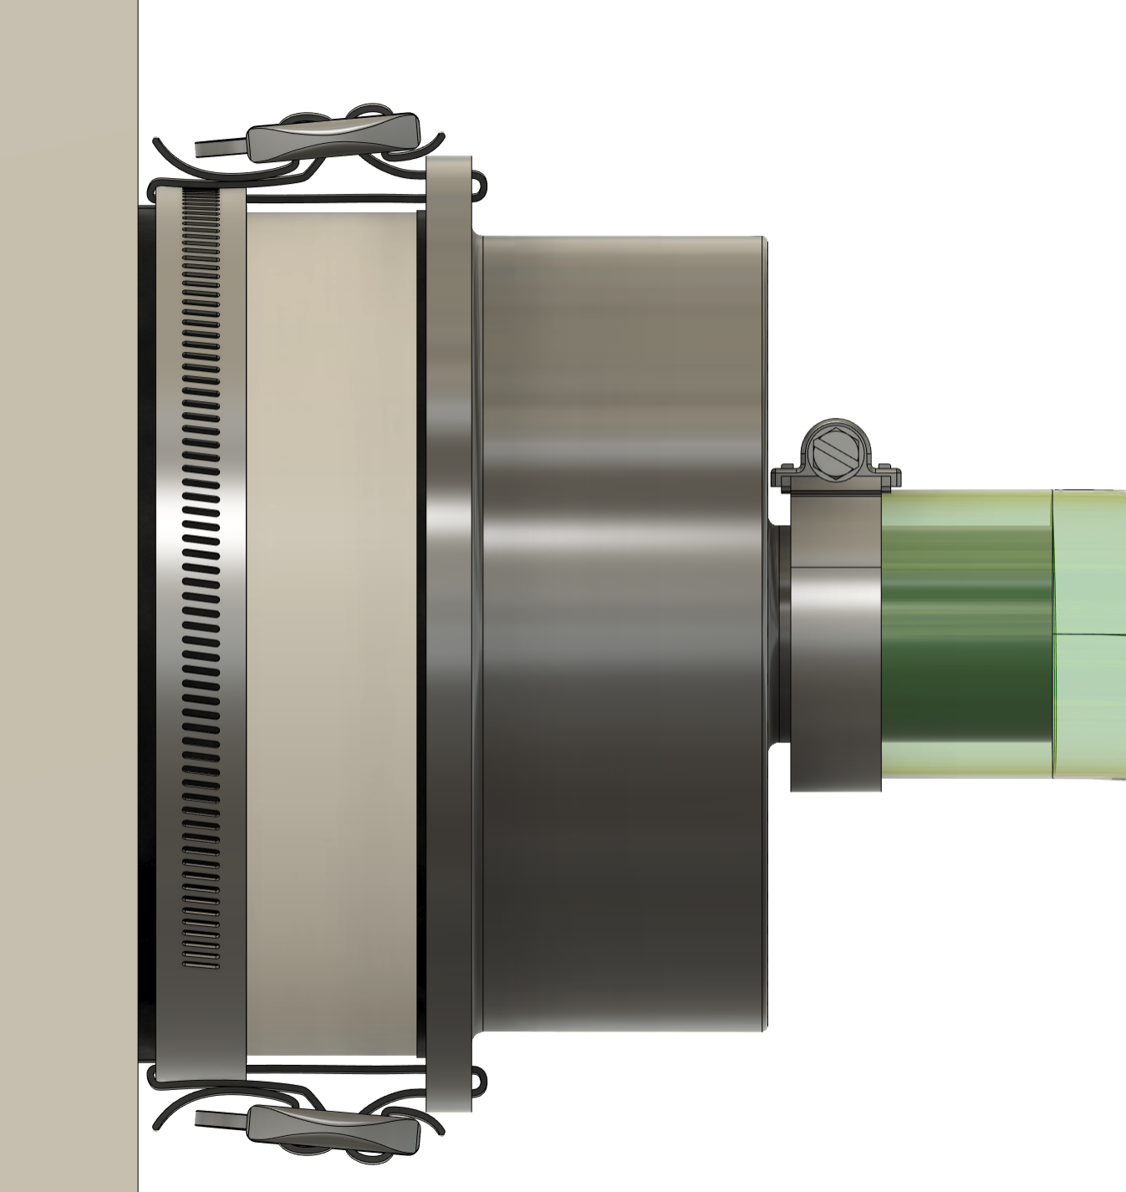
Mist Collector Hose Adapter
BATTERY
Notes:
Clarify cross sect

Slide 12

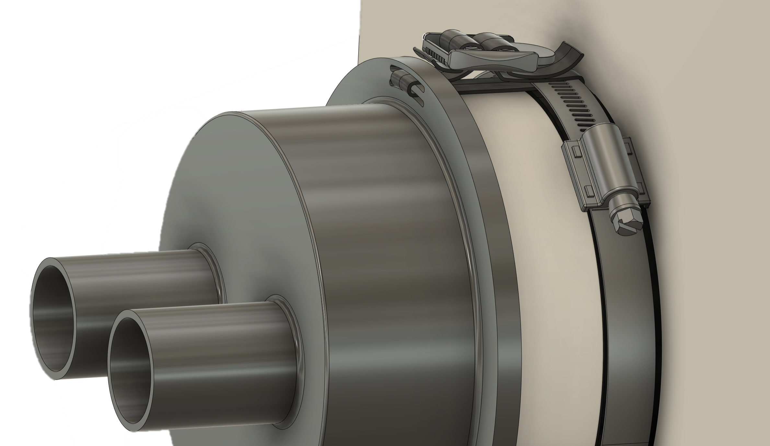
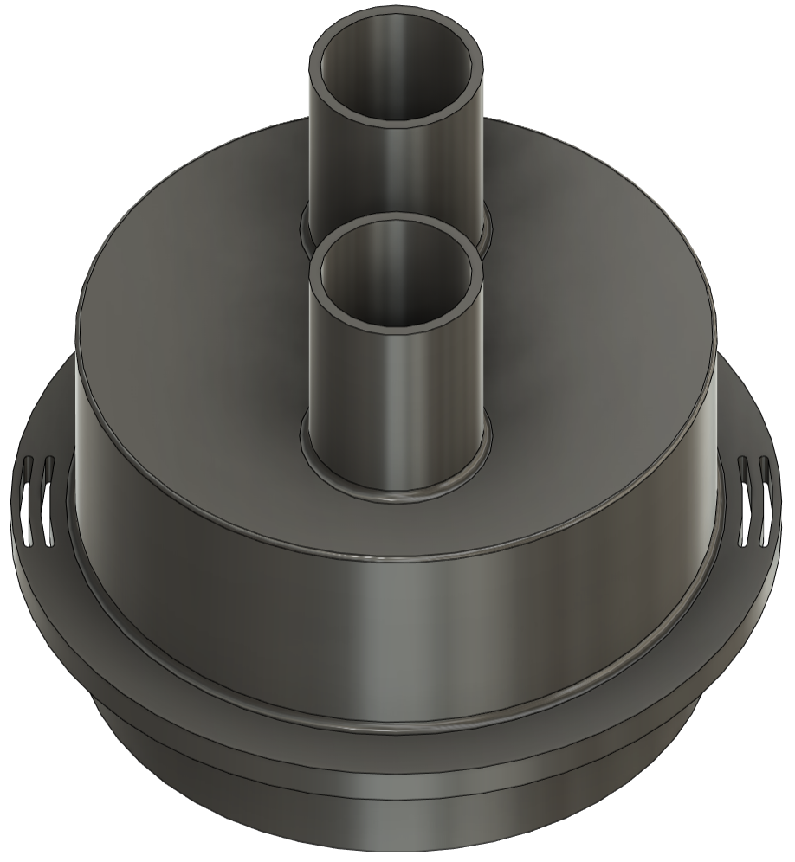
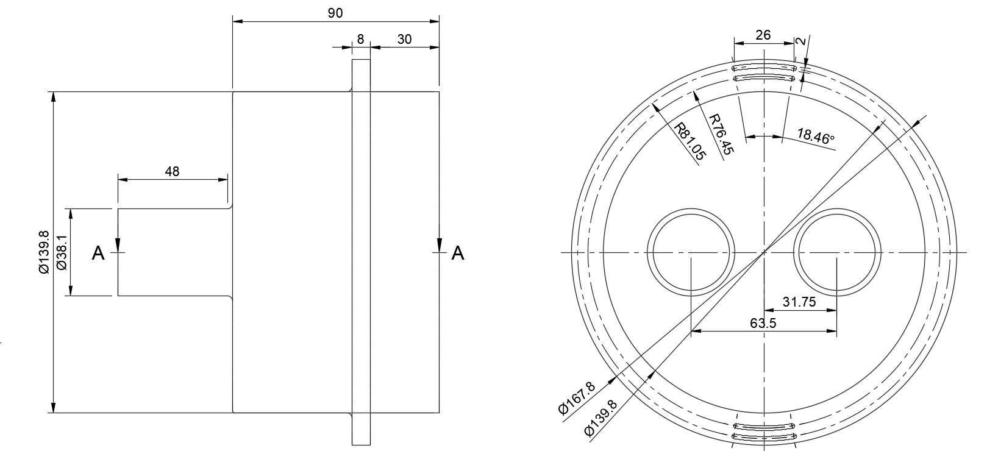
Adapter Setup
Cinching Straps
BATTERY
Hose Clamp
EPDM Foam Strip
Rubber gasket
-3D Print Short Term
-Fabricate out of Aluminum Long Term
Notes:
railcar

Slide 13
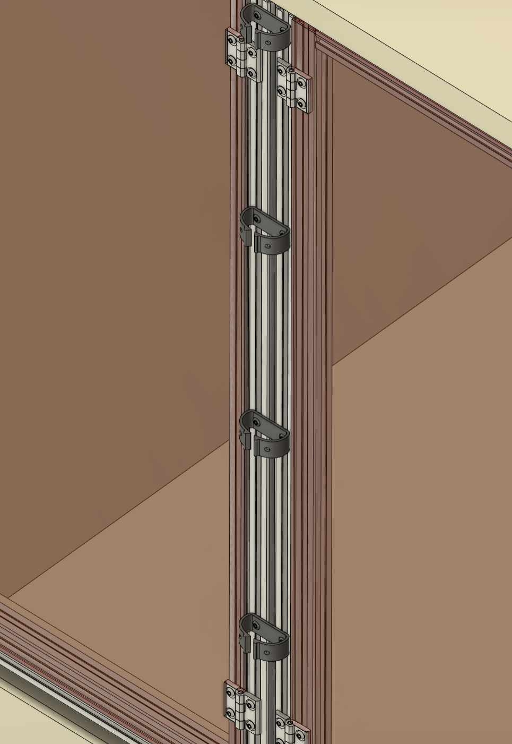
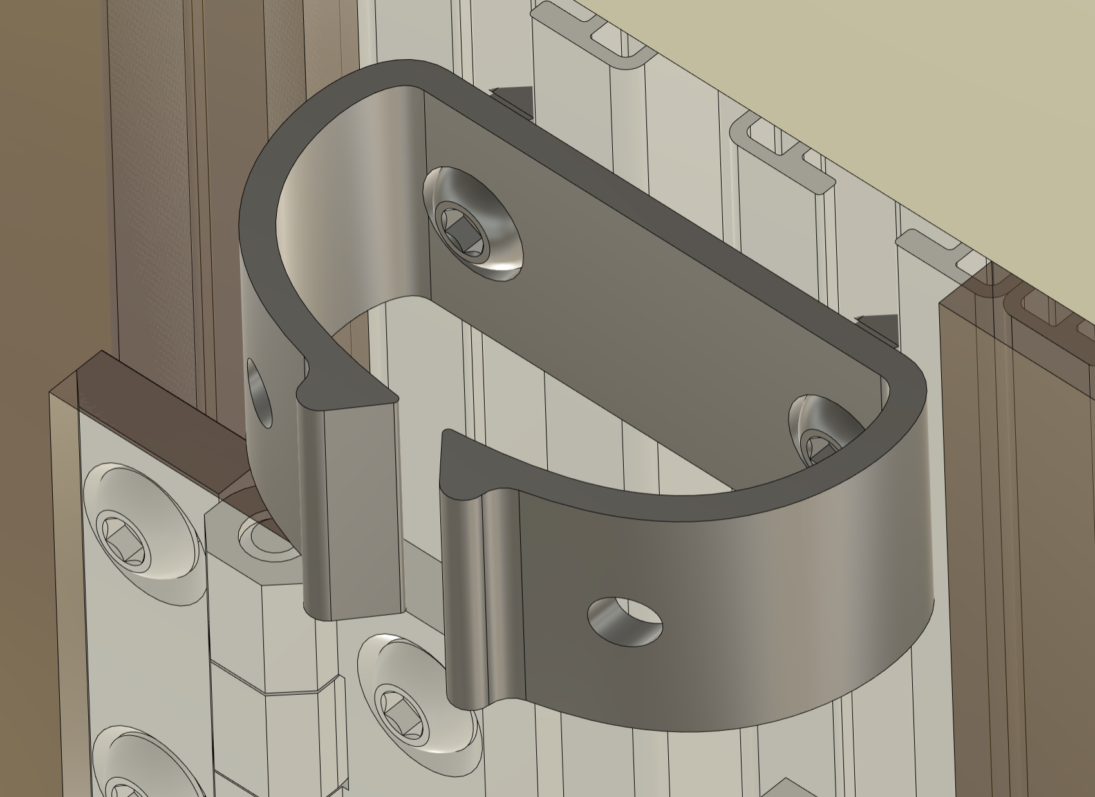
Wire/Hoses Clip Setup
BATTERY
T Slot Screws
Location

Slide 14
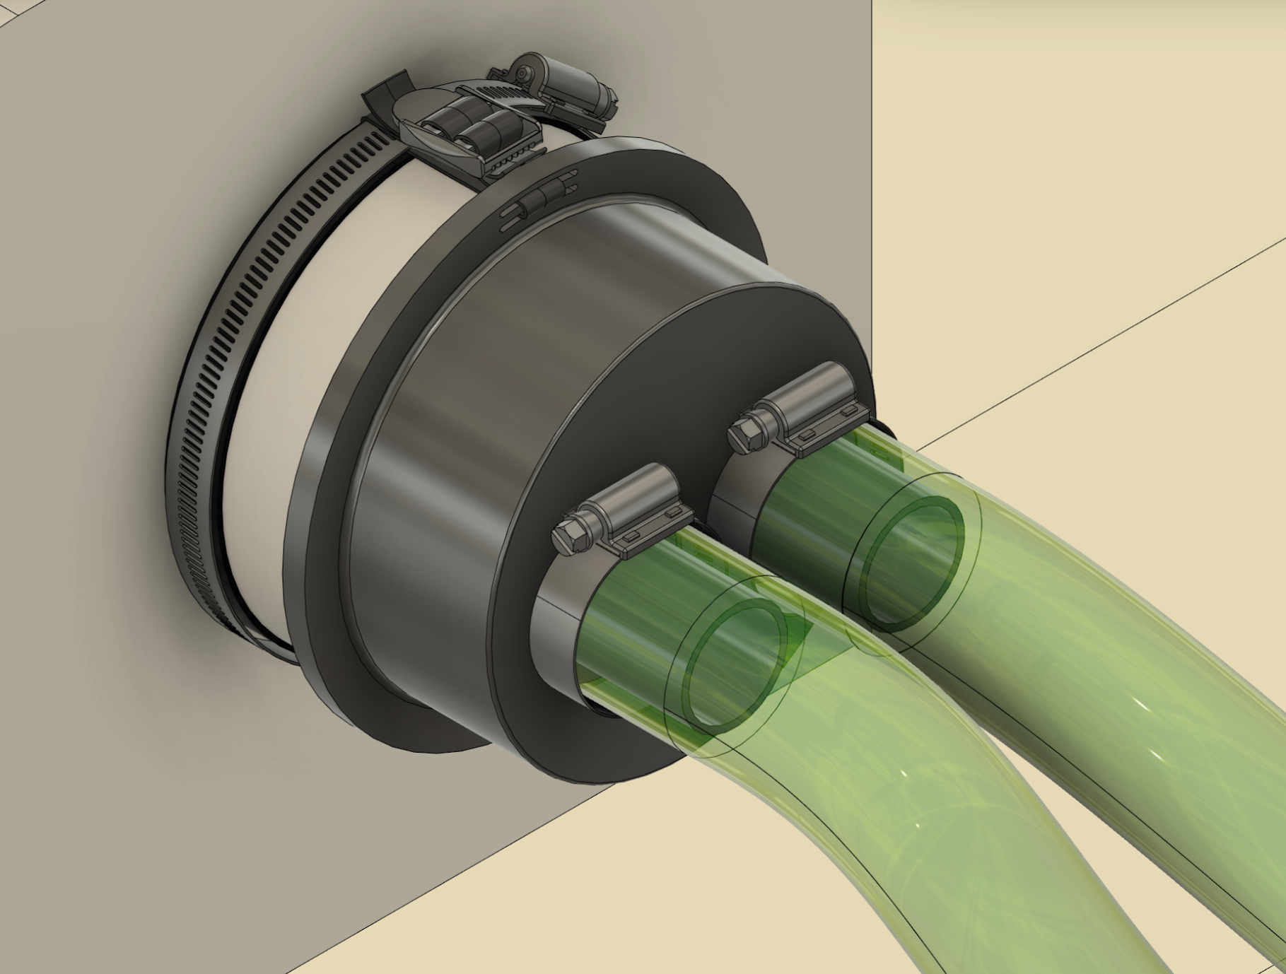
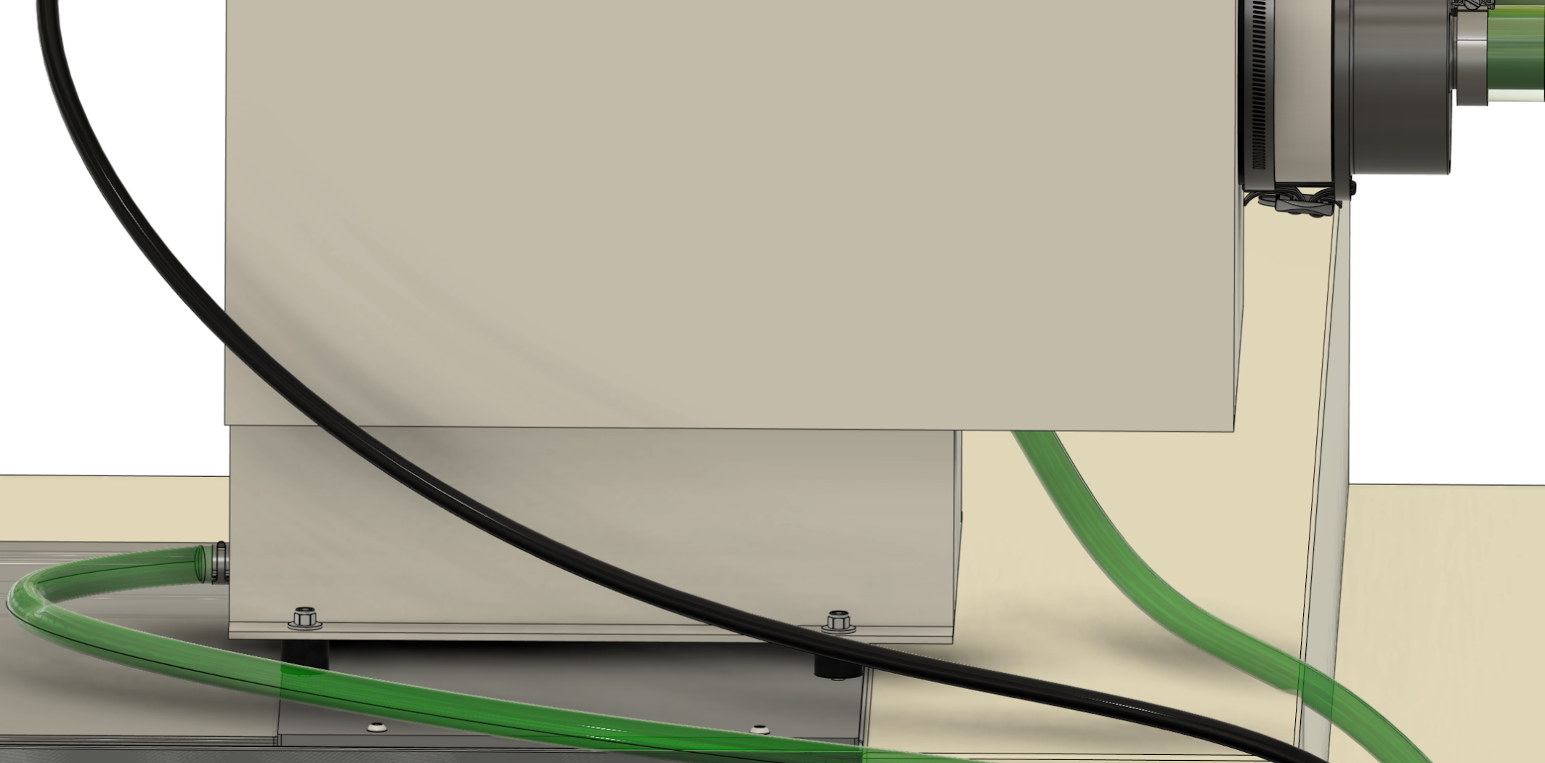
Installation & Hose Attachment
BATTERY

Slide 15
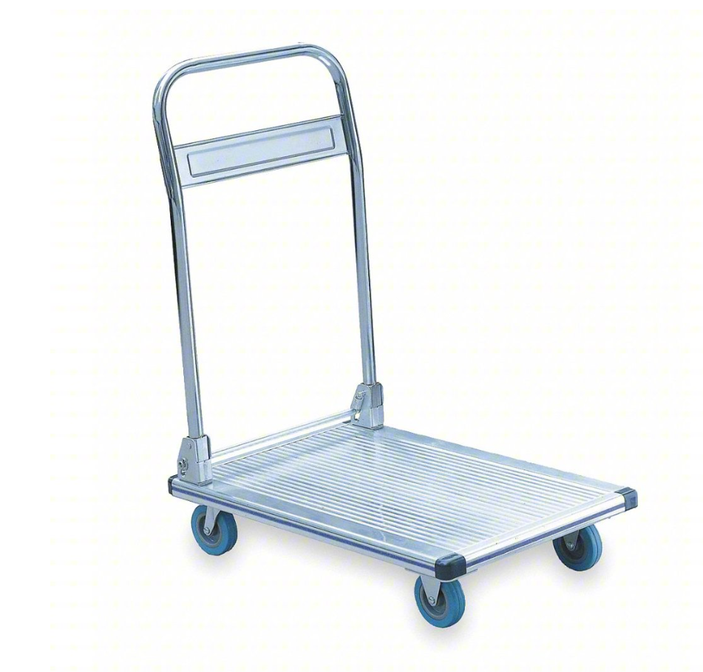
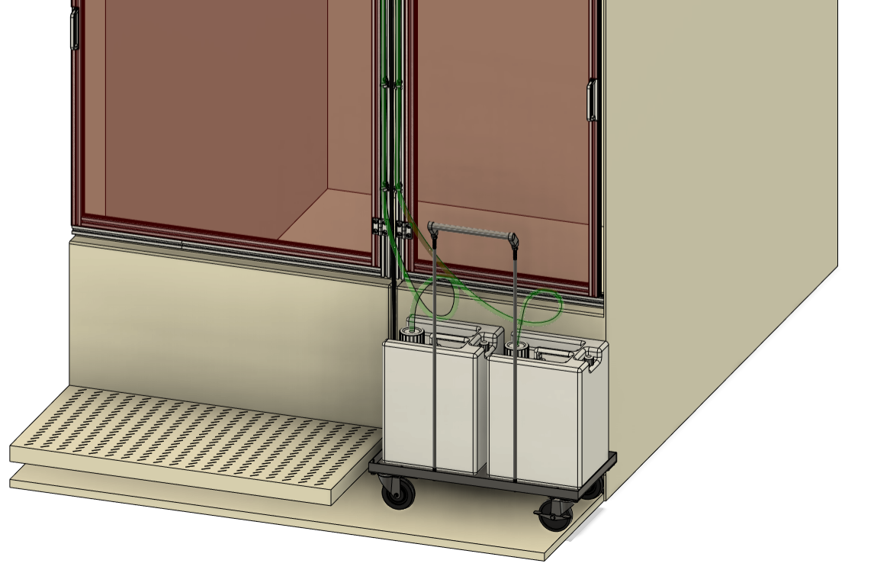
Cart Setup
BATTERY
Aluminum platform truck

Slide 16
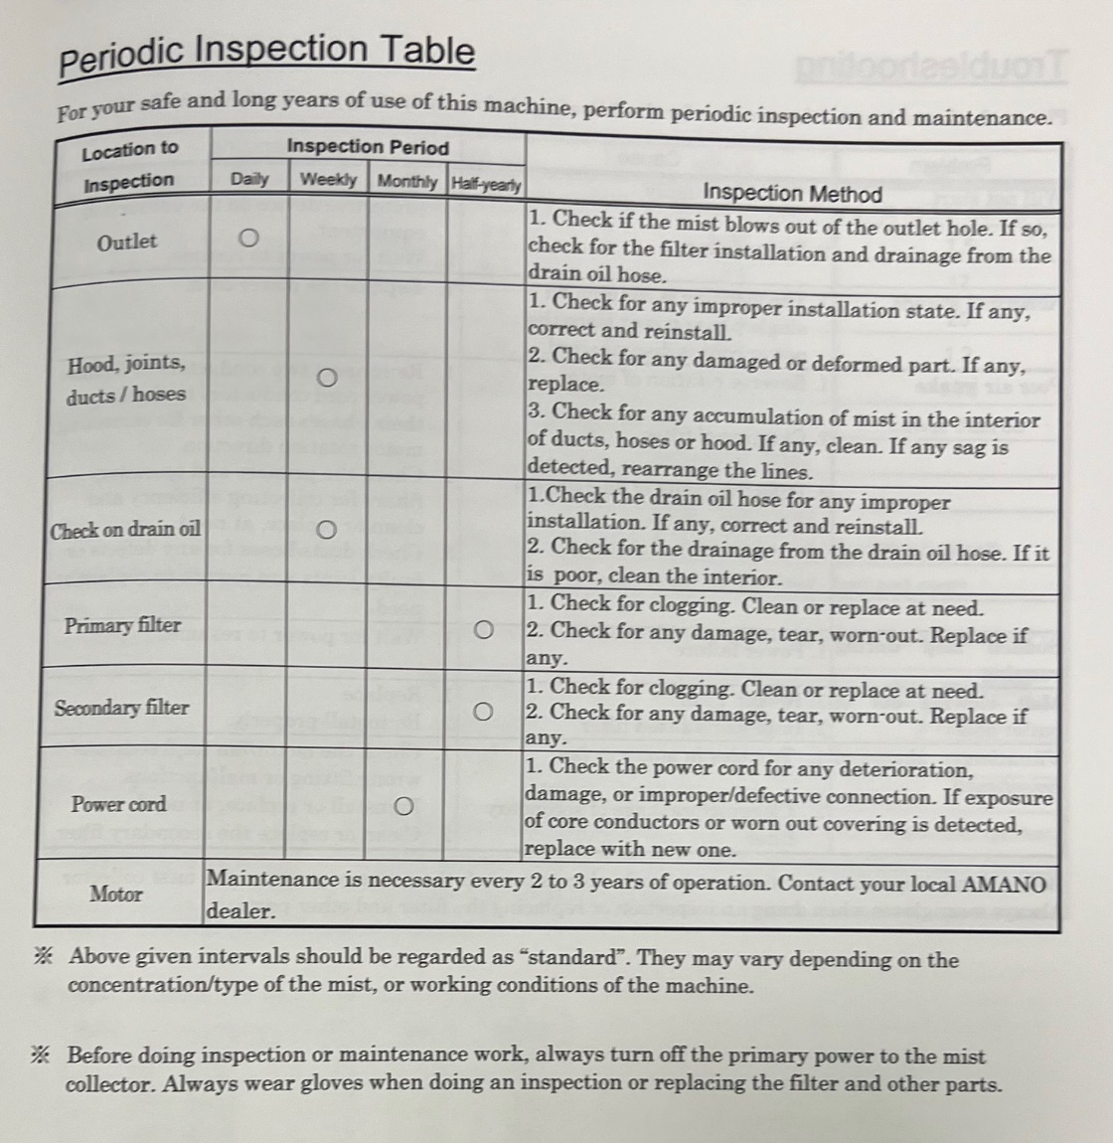
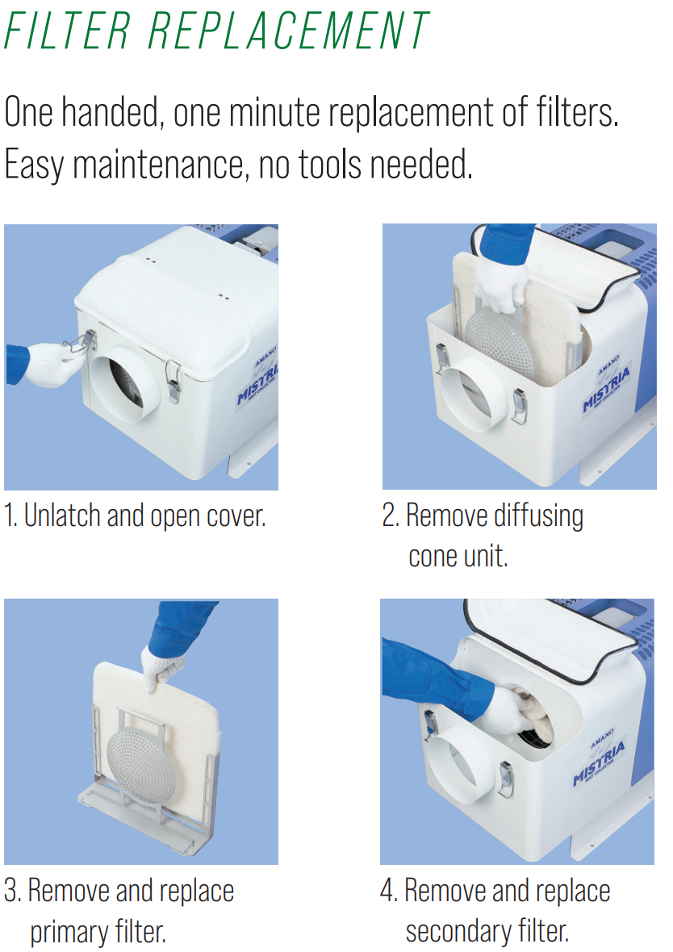
Mist Collector Maintenance
BATTERY
Check filters every 6 months

